Slide 1
Touch-on-Cloud One

Slide 2
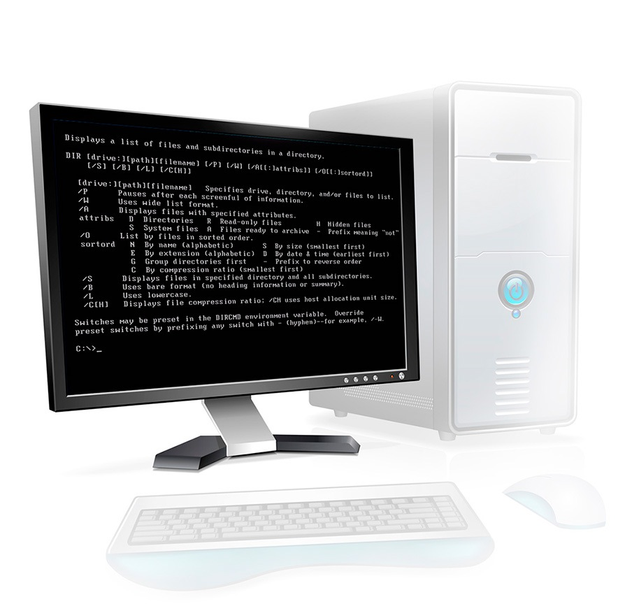
Q: What would computing be without an Operating System?
A: Portable screen and storage device.
Data is not managed and hardware does not communicate

Slide 3
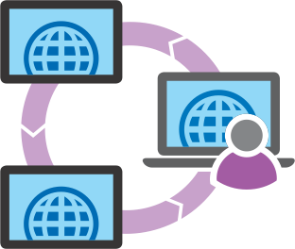
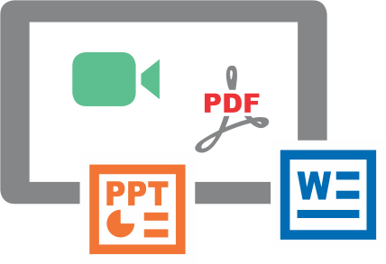
Similarly, Education also needs an “Operating System”
Collaboration
Coaching
Leverage the power of networked devices and networked people
Provide personalisation at scale
To enable these exchanges in real-time
Live Versatile Whiteboard
Management
Provide a way to manage & open proprietary content on modern devices
Live versatile whiteboard

Slide 4
Education today does not have a single platform
Which will:
Unify the use of technology
Reduce scatter of classroom activity
Make learning inclusive and efficient

Slide 5
Touch-on-Cloud One
World’s First Learning Operating System
Designed for 1:1 device classrooms and online learning

Slide 6
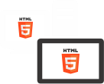
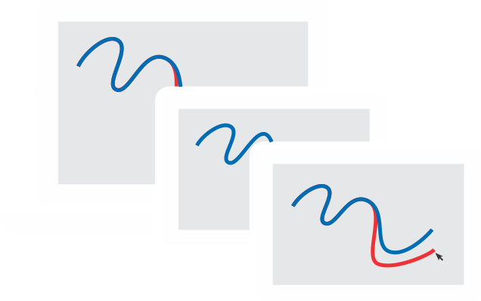
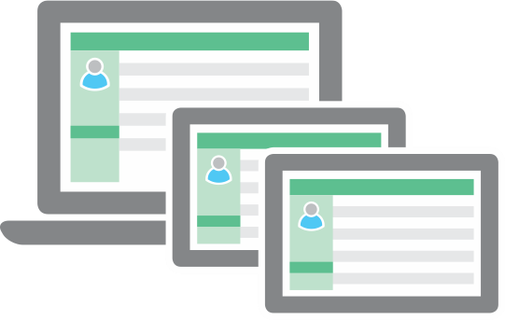
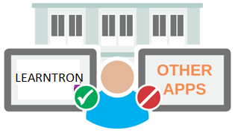
Touch-on-Cloud One: 3 innovations for bringing alive 3 exchanges
Management
Coaching
Collaboration
Live, Versatile whiteboard
Plaza of pedagogical tools
Ingenious learning management system

Slide 7
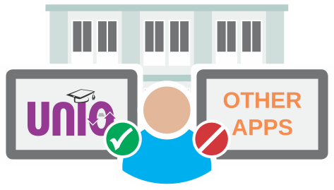
Management
Coaching
Collaboration
Live, Versatile whiteboard
Plaza of pedagogical tools
Ingenious learning management system

Slide 8
The teacher’s board has limitations across the continuum
Collaboration
Blackboard
IWB
Screen sharing
(in online or 1:1 classrooms)
Space
Very limited
Not limited, but only for Teachers
Usually limited to screen size
Dynamic content management
Absent
Available, but only for Teachers
Available, but requires toggling apps
Interactivity
Absent
Present, but not all the time
Present, but not all the time
Live Collaboration
Absent
Absent
Absent
Result: Most lecturing, even today is one way, and boring

Slide 9
Touch-on-Cloud One introduces Live, Versatile, Collaborative white-boarding
Collaboration
Class-04 Rational Numbers
Students
05
Embed
Class-04 Rational Numbers
Assess
Embed
Live broadcast of teacher annotations to all participants
Independent student annotations as a separate layer
Assess

Slide 10
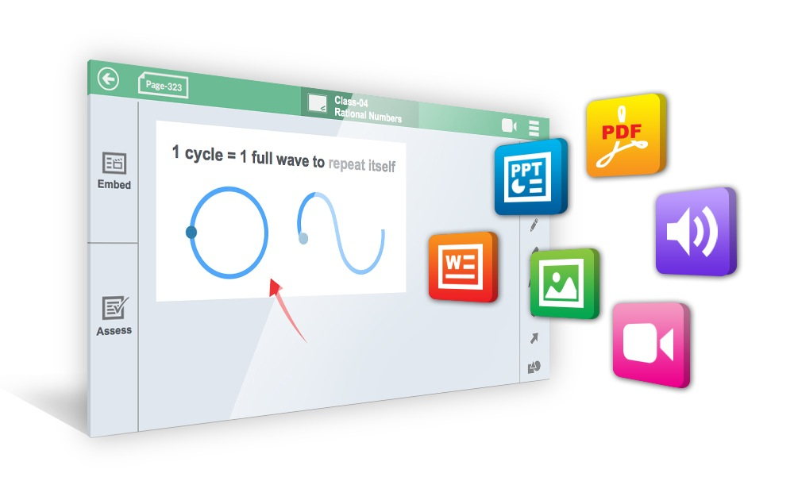
Dynamic content integration at the touch of a finger…
Collaboration
Live-view of student network
Manage Students
Questions
Stephen
Lisa
1 cycle = 1 full wave to repeat itself
Lock
to repeat itself
Raise Hands
annotation
Offline
THE BEST PART: Scalable to 1000s of concurrent users (light on data consumption)

Slide 11
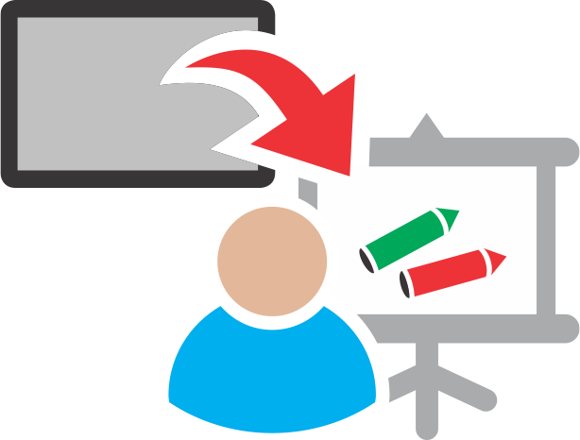
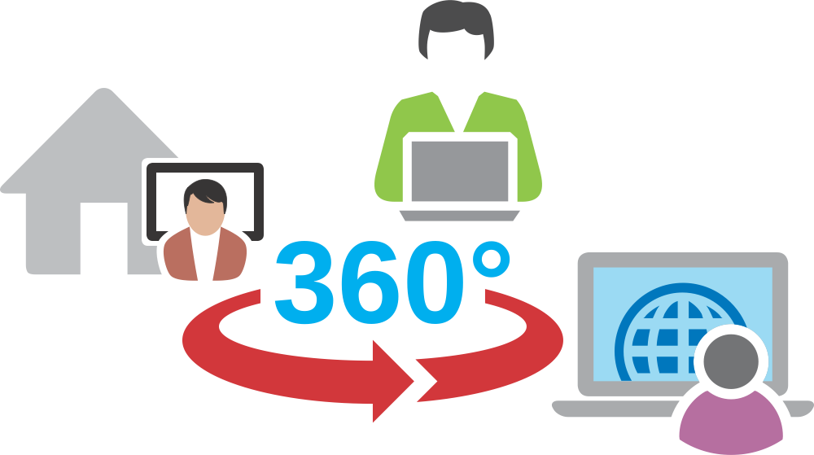
Every device becomes the Participant’s Personalised White-board
Collaboration
No more duplication of teacher notes, or best student’s work
Students notes saved instantly
Curated by the teacher, students can instantly see each other’s work
No limitation on what content can be embedded on any page
Students do not have to be in the same location to collaborate

Slide 12
Management
Coaching
Collaboration
Live, Versatile whiteboard
Plaza of pedagogical tools
Ingenious learning management system

Slide 13
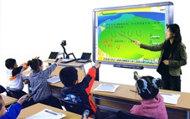
Technology has taken the personal touch out of pedagogy and power away from the teacher
Coaching
Evolution of pedagogies
Pros
Cons
The teacher sits at the centre. Highly personalised.
Not scalable.
No defined content.
Gurukul
Content defined. Scalable.
Lesser power to the teacher.
Chalk and Talk
Content gets better with visuals. Faster coverage of curriculum.
Even lesser power to the teacher. Even lesser personalisation.
ICT enabled
The teacher moves back to the centre. Learn at your pace.
Limited student-teacher interaction.
Online / MOOC

Slide 14
Touch-on-Cloud One reinvents the core of education delivery with its Plaza of Pedagogical tools
Coaching
Plan
Teach
Assess
Share
Built on the best slice of each pedagogy in evolution

Slide 15
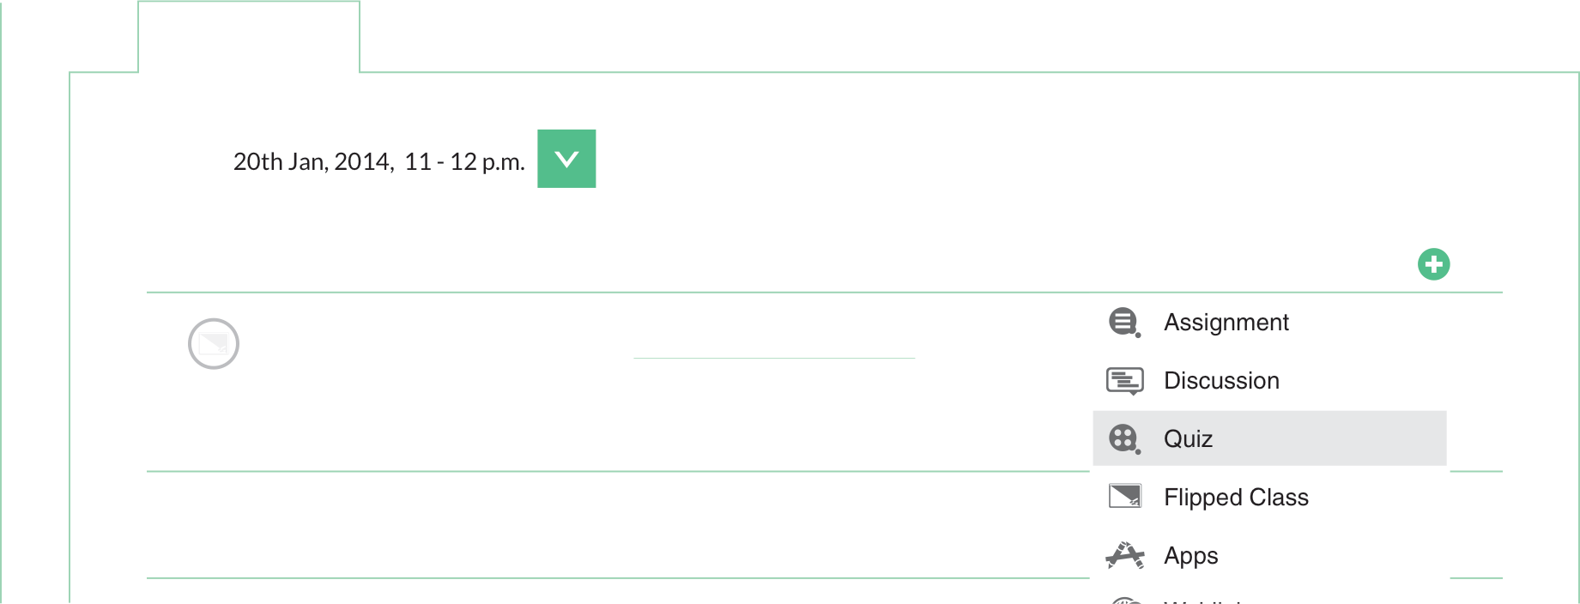
Plan every lesson in great detail. Flipped sessions integrated as pre or post class activity.
Coaching
Plan
Flipped learning integrated as pre or post class activity
Lesson Planning
The teacher can give flipped sessions as pre-class or post-class work from within Touch-on-Cloud One, from within the Browser.
No need to switch apps or screens.

Slide 16
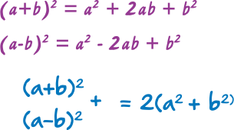
Teach with redefined personalisation.
Coaching
Teach
Personalised Learning
Class - 04 Rational Numbers
Questions
Stephen
Lisa Andria
Lock
Raise Hands
Personalised intervention by the teacher on the student

Slide 17
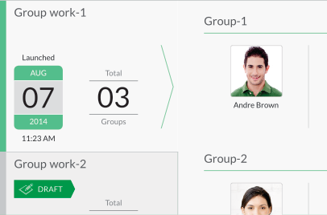
Assess learning progress in real time, and at after class
Coaching
Assess
Quiz Responses (3/5)
Manage Group work
Participants
Assignment-2
Equations
A
B
C
D
No
Embed
Quizzes with Live polling
Group Work:
Collaborative assessments
Launch and Grade audio-visual assignments

Slide 18
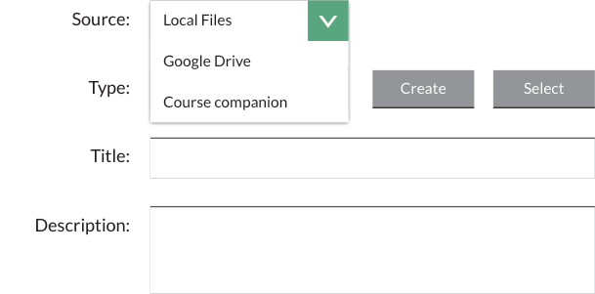
Share learning and resources freely with Touch-on-Cloud One
Coaching
Share
Discussions
Thread on ‘Should Scotland vote to be in the UK?
Select a student to grade
Grade
Akira Kato No Reply
Posted on October 9, 2014 14:40
Explain economic reasons why or why not Scotland should be part of UK
All live sessions available recorded
Quadratic Equations
David
Alex Scott No Reply
Peer-learning through social threads
Free sharing of references, files, web-links and apps

Slide 19
Touch-on-Cloud One - Plaza of pedagogical tools gets the teacher back in the centre of learning
Coaching
Plan
Teach
Assess
Share
Built on the best slice of each pedagogy in evolution

Slide 20
Management
Coaching
Collaboration
Live, Versatile whiteboard
Plaza of pedagogical tools
Ingenious learning management system

Slide 21
Most LMSs today are glorified file management systems, mostly used outside the class.
Management
Tablet Readiness
Degree of ‘LIVE’ness

Slide 22
Touch-on-Cloud One - Refreshing learning management system captures content where it is created
Management
Tablet-first Product
First-ever totally live LMS
Superior Administrative Control
Access Management

Slide 23
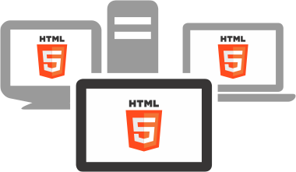
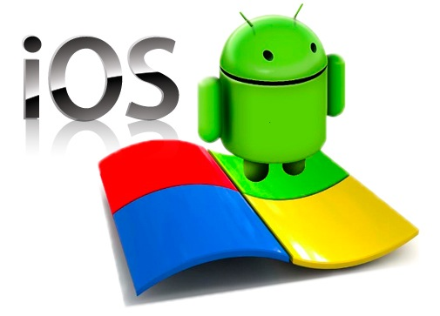
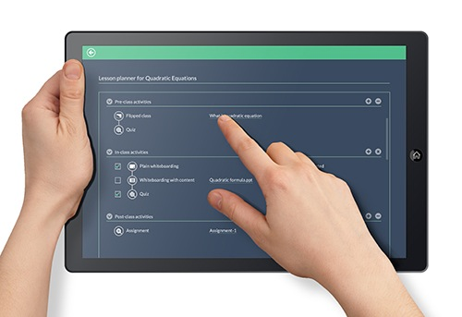
Management
Created in HTML5 - Device and OS neutral for Tablets, Hybrids and PCs
Every screen designed for touch-based input (strategic buttons accessible by the thumb)
Tablet-first product
No need for different apps for each OS
Engineered Palm rejection - for easy writing

Slide 24
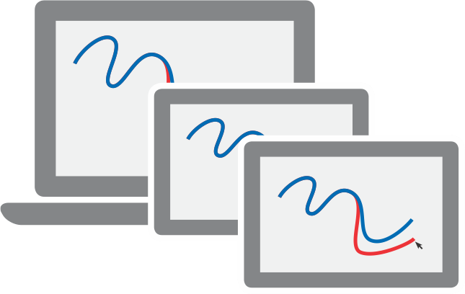
Management
First-ever totally live LMS
For the first time, teacher white-boarding becomes a part of the LMS
Live quizzes and assignments also saved to the lesson
Every stroke of the pen / cursor by the teacher or student, in class or off-class is saved

Slide 25
Management
Access Management
During school hours, students will not be able to access other apps
Built for iOS, Android and Windows

Slide 26
Management
Superior Administrative Control
Please send screenshot of this
Please send screenshot of this
Email notifications for upcoming classes, pre / post-class notifications, pending assignments and pending tasks
Daily management report on faculty feedback and usage
Please send screenshot of this
Upward feedback on faculty by students at the end of every class

Slide 27
Everyone has internet
Touch-on-Cloud One
Everyone will have devices
World’s First Learning Operating System
True education will result from learning in union

