Slide 1
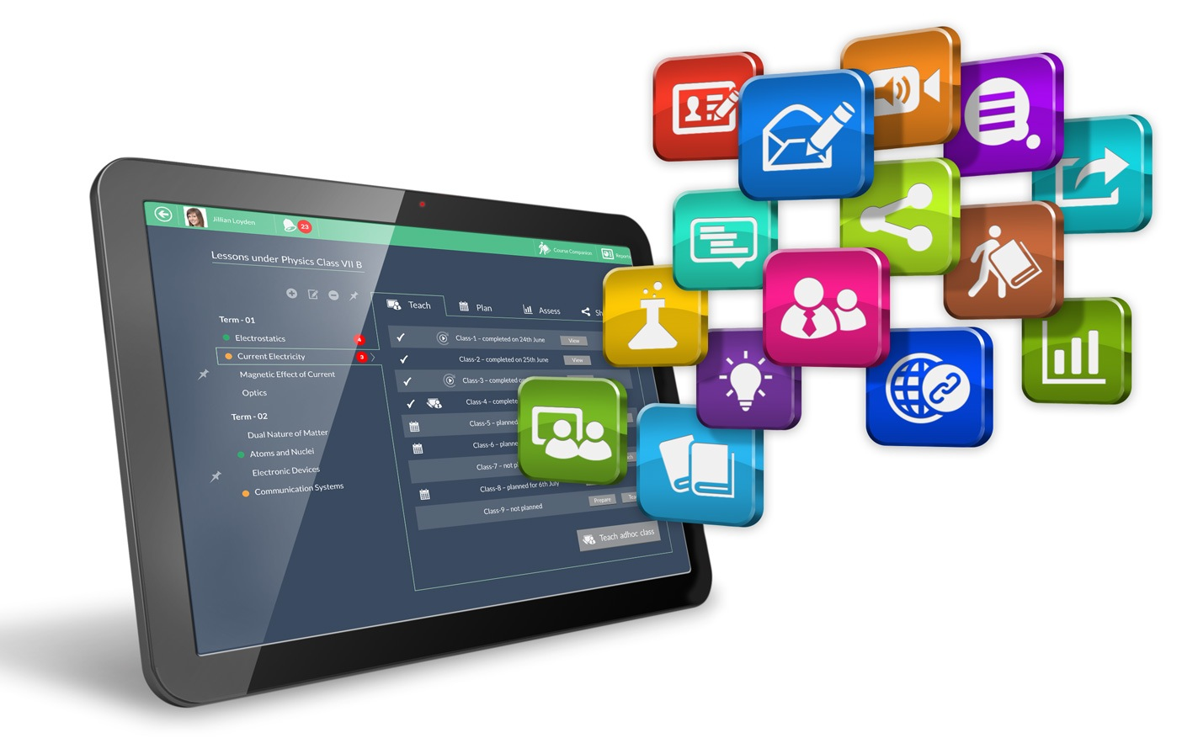
Touch-on-Cloud-One
Competitive Analysis

Slide 2
Touch-on-Cloud-One is uniquely positioned as a new-age LMS with comprehensive features of a classroom management & scalable solution for online learning
Touch-on-Cloud-One
Learning
management
Systems
Apps for
classroom
management
Platforms for
Web Conferencing

Slide 3
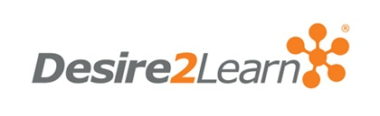
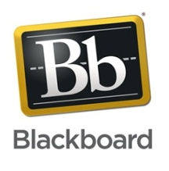
Touch-on-Cloud-One vs LMSes: Most LMSs today are glorified file management systems, mostly used outside the class
High
Touch-on-Cloud-One is a mobile-first product with a high degree of live collaboration, unlike other LMSes
Touch-on-Cloud-One
Tablet Readiness
Was the LMS made for the tablet?
Low
Degree of ‘LIVE’ness
How much of live collaboration and learning does the LMS capture?
High

Slide 4
Touch-on-Cloud-One vs classroom management apps: Touch-on-Cloud-One is a more sophisticated learning delivery product than other standalone apps
High
Touch-on-Cloud-One is a full fledged LMS which is cross platform, unlike other classroom management apps
Touch-on-Cloud-One
Platform with content structured around curriculum, mainly used by Teacher to project content.
Cross platform support
Samsung school works only on high-end Samsung Note tablets. Samsung India has entered into a contract with Harness for reselling Touch-on-Cloud-One on other low-cost tablets
Low
Depth of LMS features
High

Slide 5
Touch-on-Cloud-One vs Web Conferencing: Touch-on-Cloud-One is more scaleable and more geared for the learning use-case than other web conferencing products
High
Touch-on-Cloud-One can scale to thousands of concurrent users. Audio-video can scale to 500 concurrent users based on latest webRTC technology
Touch-on-Cloud-One
Based on age-old flash technology which is not very scalable. The User-Interface is clumsy and not intuitive
Scaleability
Google Hangout and Skype are not a learning product, they were built for online meeting and conferences. While audio can scale to few hundred users, screen-sharing falls apart with users running on low bandwidth connections in India. Not relevant for one-to-many teaching at all
Low
Suitability for learning
High

Slide 6
Feature comparison summary across products

Slide 7
Feature Comparison –
A) Classroom Collaboration
No | Feature List | Touch-on-Cloud-One | LMS |  |  | Classroom Management |  | Web Conferencing
 |  |  | Canvas | BB | Moodle | Samsung | Tata / Nearpod | Skype / Hangout | Adobe / wizIQ
1 | Teacher Screen Broadcast - Live sharing of teacher screen to all student consoles. | Yes | Yes | Yes | No | Yes | Yes | Yes | Yes
2 | Student screen share - Teacher can invoke / check student work or broadcast it to others live | Yes | No | No | No | Partial | No | No | No
3 | Teacher Annotation - Teacher can freely white board and annotate alongside embedded content. | Yes | No | No | No | Partial | No | No | Partial
4 | Student Annotation - Students can write personalized notes along with teacher notes | Yes | No | No | No | No | No | No | Partial
5 | Multi-layer view - The ability to view teacher and student annotations separately by each student | Yes | No | No | No | No | No | No | No
6 | Presenter Control - Make student as a Presenter | Yes | Partial | Partial | No | No | Partial | Yes | Yes

Slide 8
Feature Comparison –
B) Classroom Management & Control
No | Feature List | Touch-on-Cloud-One | LMS |  |  | Classroom Management |  | Web Conferencing
 |  |  | Canvas | BB | Moodle | Samsung | Tata / Nearpod | Skype / Hangout | Adobe / wizIQ
1 | Manage Students - Live Mosaic view of Students screen | Yes | No | No | No | Yes | Partial | No | No
2 | Student Control Features - Lock (canvas annotation not allowed)/ Bank (screen blanked) for specific or all student screens | Yes | No | No | No | Yes | Partial | No | No
3 | Student Attendance - Auto tracking student attendance based on their activity in the class | Yes | No | No | No | No | No | No | Partial
4 | Intelligent Course Structuring- Smartly storing all the learning artefacts & assessments as per the lessons created for easy retrieval | Yes | Yes | Yes | Yes | Partial | Partial | No | Yes

Slide 9
Feature Comparison –
C) Blended Content Generation
No | Feature List | Touch-on-Cloud-One | LMS |  |  | Classroom Management |  | Web Conferencing
 |  |  | Canvas | BB | Moodle | Samsung | Tata / Nearpod | Skype / Hangout | Adobe / wizIQ
1 | File Format Supported - PPT, PDF, Word, Images, HTML5, ePub, MP4 videos, MP3 videos, etc | Yes | Yes | Yes | Yes | Partial | No | Partial | Partial
2 | MOOC Integration – Youtube for education, Gooru Learning, Wikipedia, Google Images, etc | Yes | Partial | Partial | Partial | No | No | No | No
3 | Teacher Drop-box functionality - Dedicated unlimited space file storage for each teacher | Yes | Yes | Yes | Yes | No | No | No | Partial
4 | Embed from Camera - Using Camera embed images to canvas | Yes | No | No | No | Yes | Yes | No | No
5 | Versatile Canvas - Ability to embed multiple file format on the same page alongside teacher / student annotations | Yes | No | No | No | No | No | No | No

Slide 10
Feature Comparison –
D) New Pedagogies
No | Feature List | Touch-on-Cloud-One | LMS |  |  | Classroom Management |  | Web Conferencing
 |  |  | Canvas | BB | Moodle | Samsung | Tata / Nearpod | Skype / Hangout | Adobe / wizIQ
1 | Interactive Video Recording - Recording classroom teaching | Yes | No | No | No | No | No | Yes | Yes
2 | Flipped Classroom – Ability to flip classroom with interactive, feature-light, IP protected video format | Yes | No | No | No | No | No | No | No
3 | Detailed Lesson Planning - Structure lessons with pre-class, in-class and post-class activities | Yes | Partial | Partial | Partial | No | No | No | No
4 | Group Work - Collaborative white-boarding between students by dividing them into groups for in-class activities | Yes | No | No | No | Yes | Partial | No | No
5 | Student-led sessions – Making students presenters and getting them to present with annotation / document broadcast | Yes | Partial | No | No | No | No | Partial | Partial

Slide 11
Feature Comparison –
E) Assessments
No | Feature List | Touch-on-Cloud-One | LMS |  |  | Classroom Management |  | Web Conferencing
 |  |  | Canvas | BB | Moodle | Samsung | Tata / Nearpod | Skype / Hangout | Adobe / wizIQ
1 | Quiz - live assessment - Multiple choice quizzes can be launched and evaluated student wise live (including random / selected launch) | Yes | Yes | Partial | Partial | Yes | Yes | No | Yes
2 | Quiz - offlive assessment – Teachers can launch multiple-choice quizzes for students to take up at home which will be automatically corrected | Yes | Partial | Partial | Partial | No | No | No | Partial
3 | Live assessment in class - Teacher accesses a student screen and corrects classwork live | Yes | No | No | No | Partial | No | No | No
4 | Essay-type Assignments: Subjective / essay-type assignments can be published in class and students can work and submit assignments from home. Teacher can review and grade assignments from anywhere. | Yes | Yes | Yes | Yes | Partial | Partial | No | No
5 | Audio-visual Assignments - including publishing and grading of audio video questions and answers | Yes | Partial | No | No | No | No | No | No
6 | Discussion boards – graded social discussion threads | Yes | Yes | Yes | No | No | No | No | No

Slide 12
Feature Comparison –
F) Reporting, Feedback and Alerts
No | Feature List | Touch-on-Cloud-One | LMS |  |  | Classroom Management |  | Web Conferencing
 |  |  | Canvas | BB | Moodle | Samsung | Tata / Nearpod | Skype / Hangout | Adobe / wizIQ
1 | Grade Book report – Aggregating quizzes, assignments and other assessments into grade books with configurable weights | Yes | Yes | Yes | Partial | No | No | No | No
2 | Daily class upward feedback – Ability for students to rate each class / faculty and send feedback reports to management | Yes | No | No | No | No | No | No | No
3 | Daily and weekly management usage reports – Automated emails to management on daily / weekly usage | Yes | No | No | No | No | No | No | Partial
4 | Automated email alerts – Sending out automated emails for pending tasks and assignments | Yes | Yes | Partial | No | No | No | No | Partial

Slide 13
Feature Comparison –
G) Platform, Scalability and Internationalization
No | Feature List | Touch-on-Cloud-One | LMS |  |  | Classroom Management |  | Web Conferencing
 |  |  | Canvas | BB | Moodle | Samsung | Tata / Nearpod | Skype / Hangout | Adobe / wizIQ
1 | Cross-platform support: Full support for iOS, Windows and Android platforms, including desktops, notebooks and tablets | Yes | Yes | Partial | Yes | No | No | Yes | Partial
2 | Scaleability: Ability to scale to thousands of concurrent users for both whiteboard sharing and audio-video conferencing | Yes | No | No | No | No | No | No | Partial
3 | Flexiblity of hosting: Ability to host both in-campus and on the cloud | Yes | Yes | No | Yes | Partial | No | No | No
4 | Multi-lingual support: Support for multiple languages including European and RTL languages like Arabic and Hebrew | Yes | Partial | No | Partial | No | No | No | No
5 | Smartphone support: Support for smartphones using a dedicated phone app, with UI optimised for mobile phones | No | Partial | Partial | No | No | No | Yes | Yes

