Slide 1
Teacher User Manual

Slide 2
CONTENTS
Login and profile management Login Screen 03 Edit Profile 04 - 05
Course and lesson management Course Companion 06 - 07 Lesson Creation 08 - 11 Lesson Planner 12 - 15
White boarding and student management White boarding screen 16 - 17 Manage students 18 - 19 Page sorter 20 - 21 Teacher settings 22 - 23
Content management Embed from local files 24 - 26 Embed from web cam 27 - 28 Embed from web content 29 - 30 Embed from course companion 31 - 32
Assessments Quiz 33 - 41 Assignment 42 - 45 Discussion 46 - 48
Other activities Share files 49 - 52 Share web-links 53 - 56

Slide 3
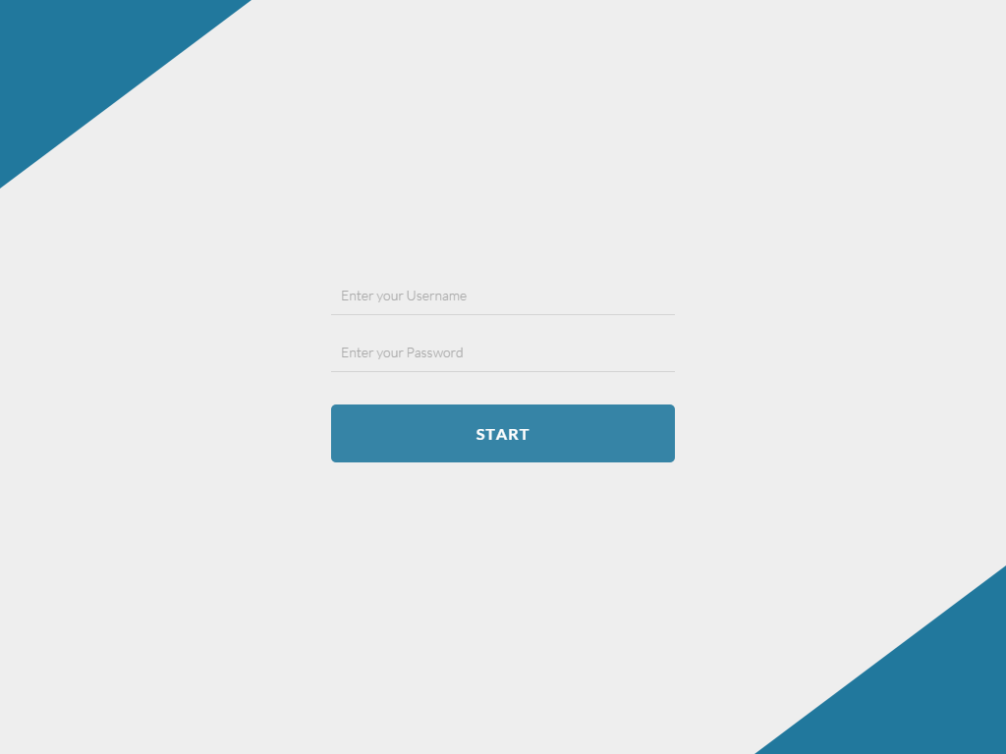
LOGIN SCREEN
1. User name
2. Password
3. Click to login

Slide 4
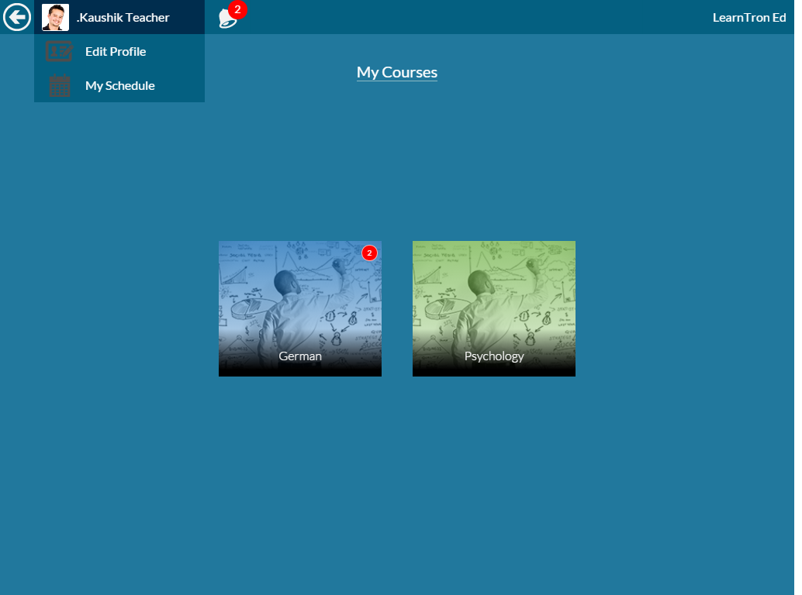
COURSE SCREEN
1. Click to edit profile
2. Click to check schedule

Slide 5
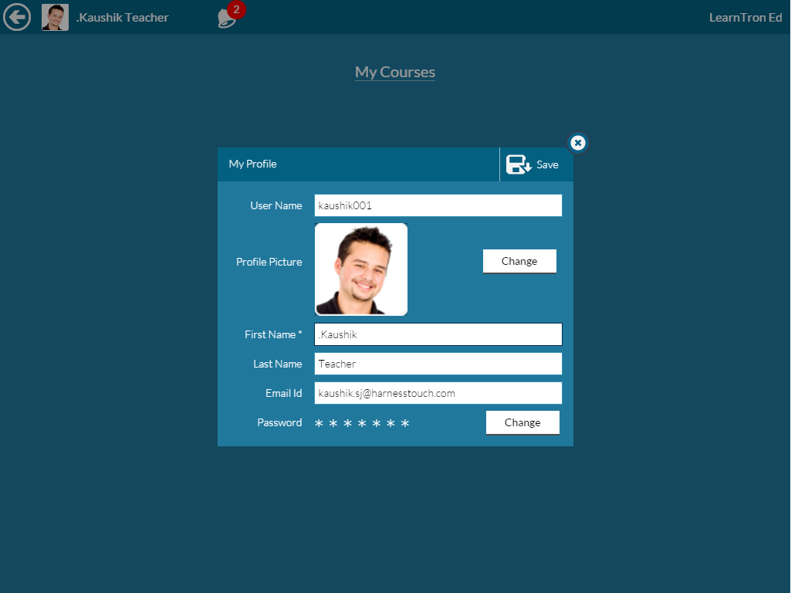
COURSE SCREEN To VIEW / EDIT PROFILE
2. Click Save
1. Enter Details

Slide 6
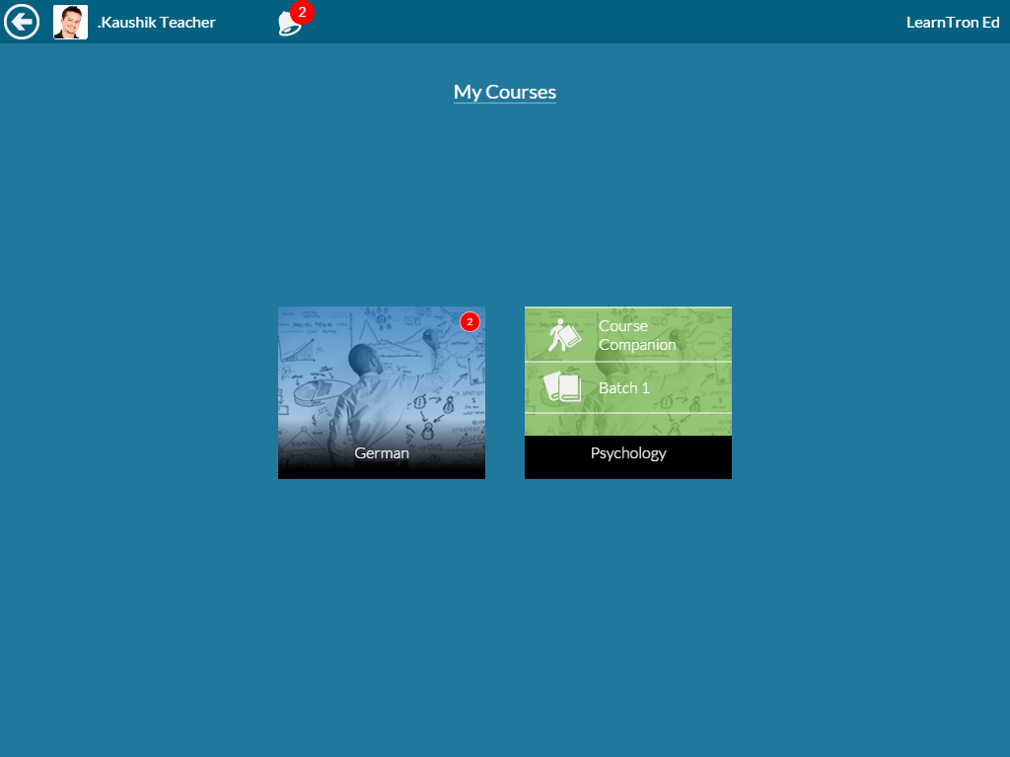
COURSE SCREEN To go to COURSE COMPANION / To go to LESSON SCREEN of a given class
Click here to go to Course Companion window
Click here to go to Lesson Screen of the selected Class
06

Slide 7
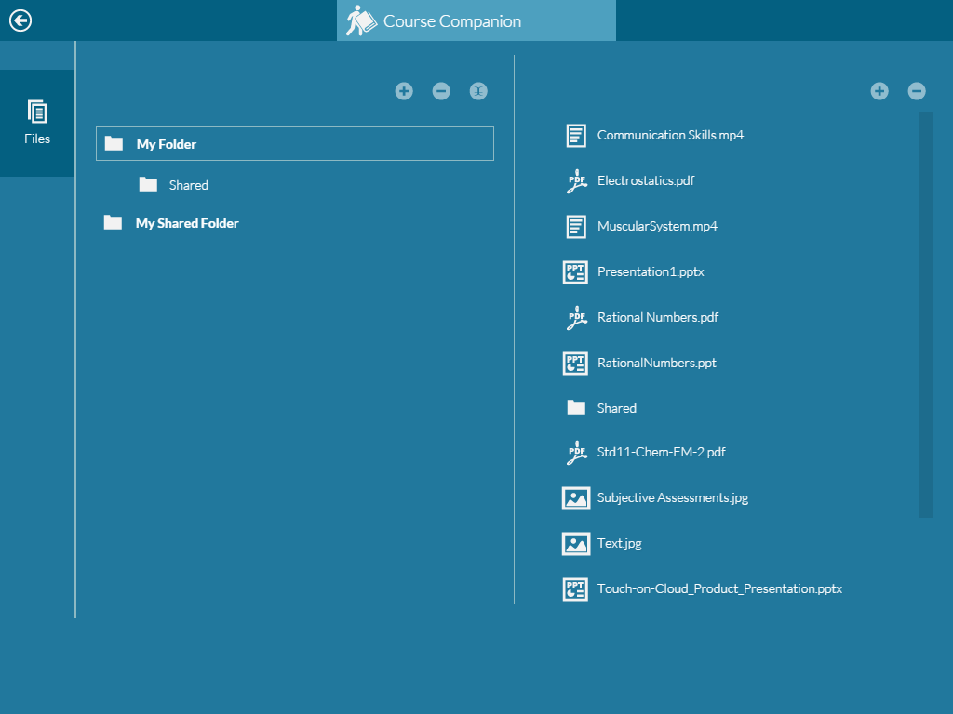
COURSE COMPANION
Back button to go to Course Screen
Add a folder
Add a file
Delete a folder
Delete a file
Rename

Slide 8
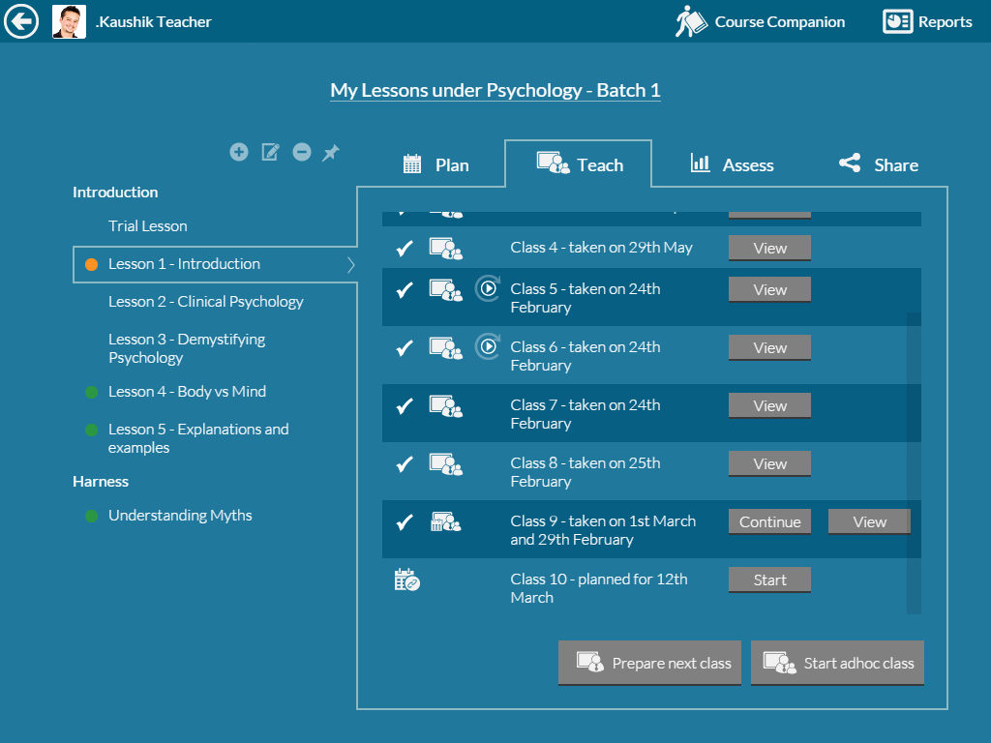
LESSON SCREEN
Modify a lesson
Add lesson name
Delete a lesson
To start a planned class
To make Lesson available offline
To prepare class in an offline mode
To start an adhoc / unplanned class

Slide 9
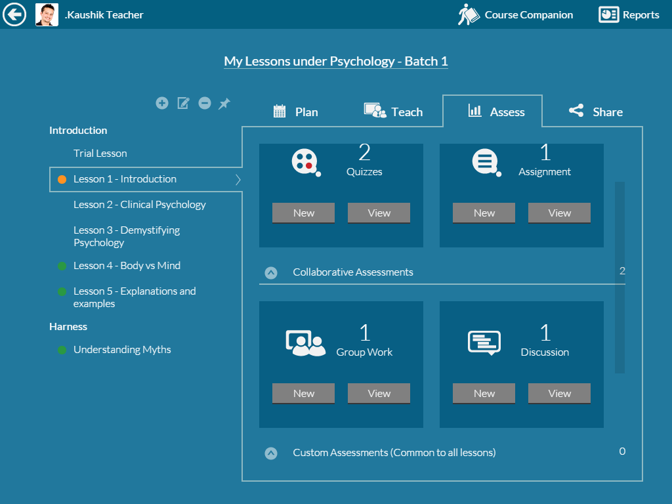
LESSON SCREEN
To open Assessments
For new Assessments
For viewing existing Assessments

Slide 10
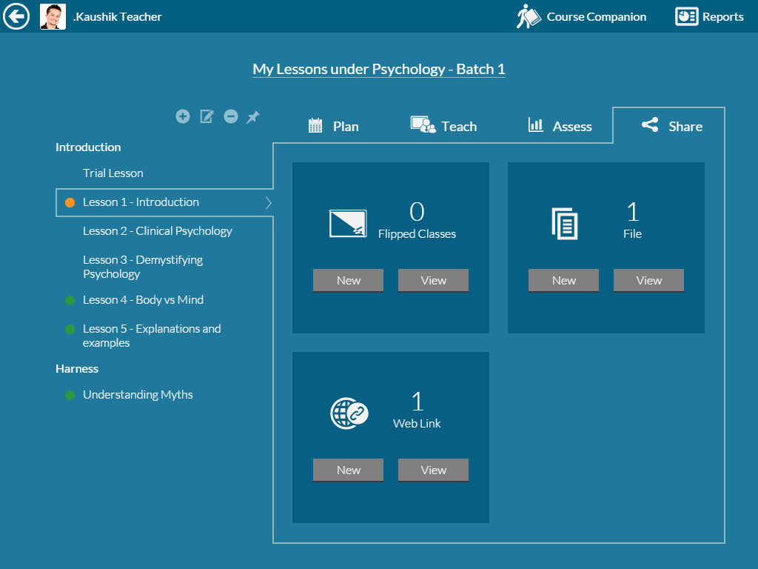
LESSON SCREEN
Click Share to open
Click new for new share
For viewing existing Share

Slide 11
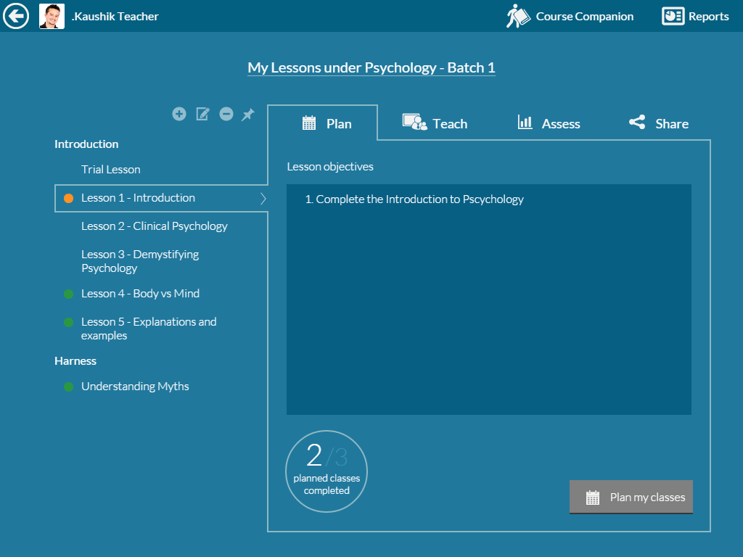
LESSON SCREEN
Click to navigate to plan class
Click to plan a new class
‘2’ Indicates no. of planned classes

Slide 12
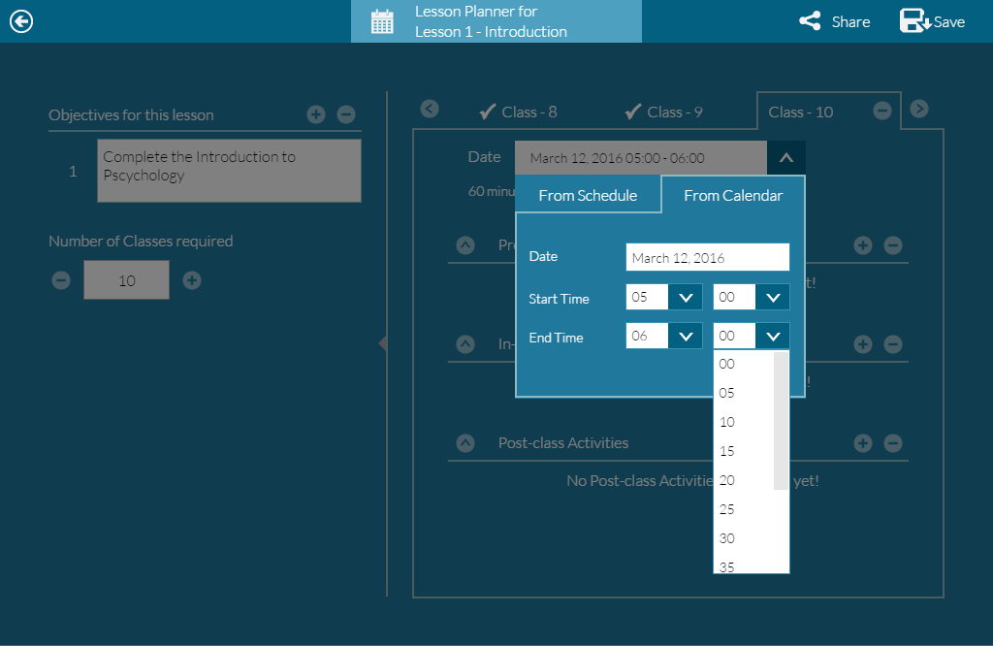
LESSON PLANNER
Add a new Objective
Enter Objective
Schedule Class
New Class

Slide 13
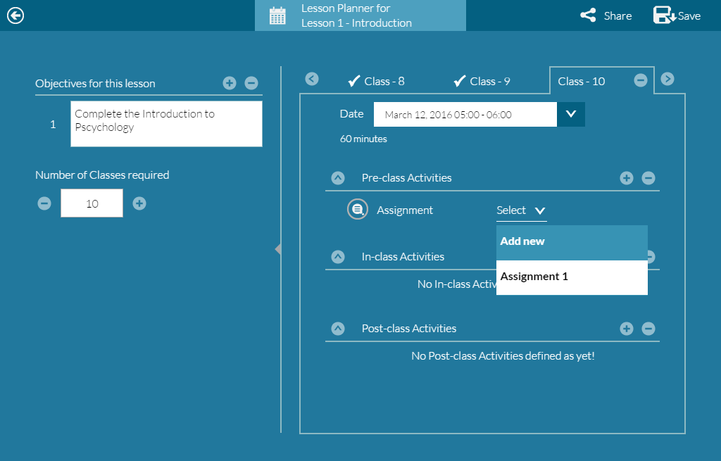
LESSON PLANNER
Click to Save
New activity
Remove activity
Select already created activity or create new activity

Slide 14
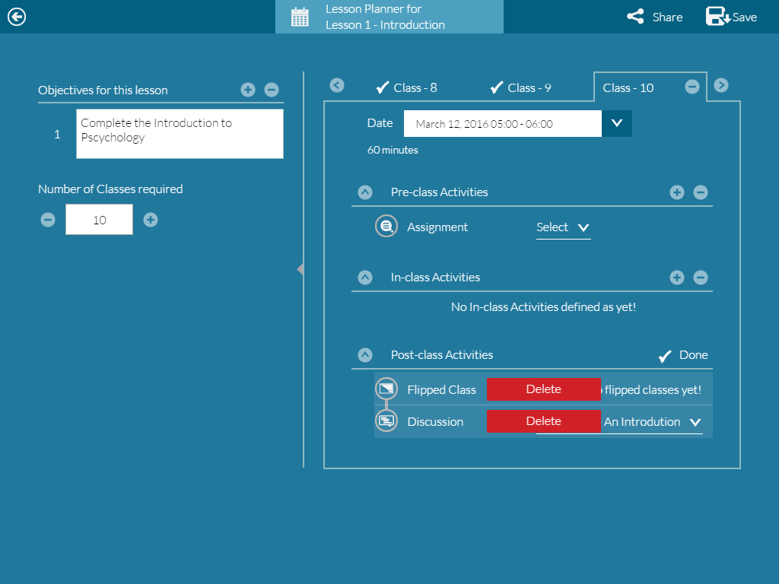
LESSON PLANNER
Deleting an activity
Click ‘Done’ after deletion

Slide 15
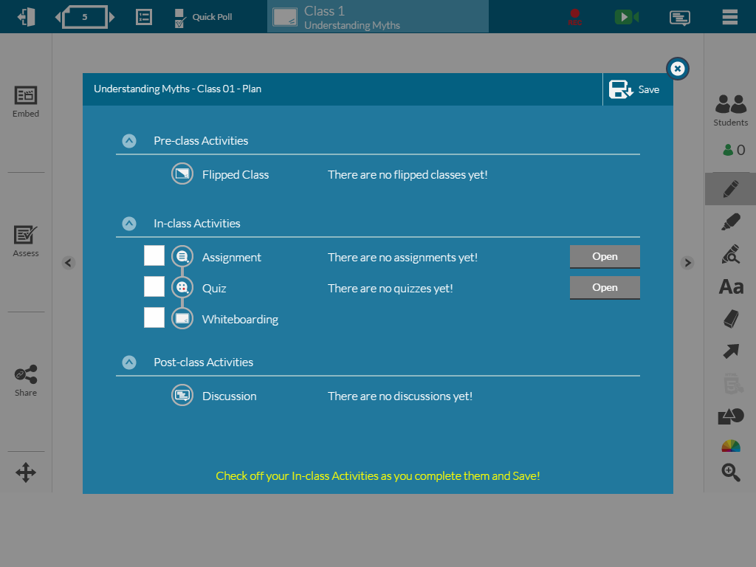
LESSON PLANNER
Click to open Lesson Planner

Slide 16
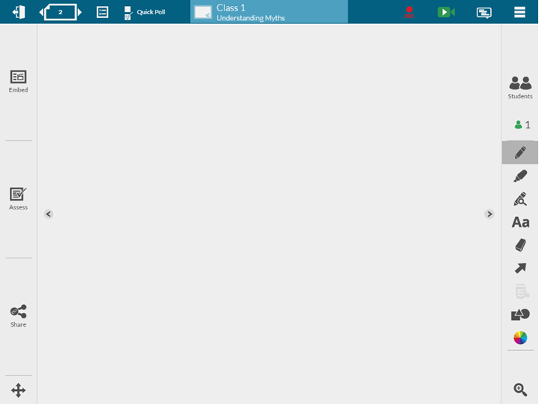
WHITE-BOARDING SCREEN – THE 6 KEY PARTS
The Embed tools – for inserting digital content on the whiteboard
The Student Management tool – for managing students
4
3
1
The whiteboard area –infinite page size, multiple pages
The Assess tools – for evaluations
5
The annotation tools – for writing and drawing on the whiteboard
2
The Share tools – for other activities
6

Slide 17
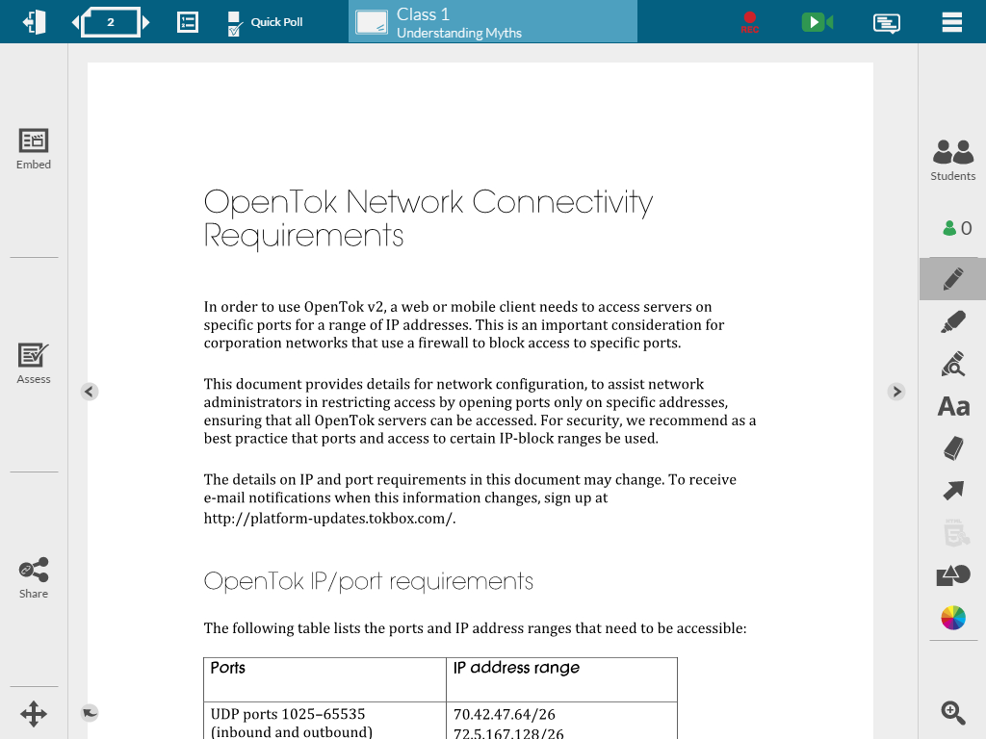
WHITE-BOARDING SCREEN – THE ICONS EXPLAINED
Quick Poll
Pen
Highlighter
Magnify Text
Text
Eraser
Select
Change properties like color, size and more…
Shapes
Pan
Undo

Slide 18
MANAGE STUDENTS
Click here to open ‘Manage Students’ screen
Auto Tracking of the number of students connected to the class

Slide 19
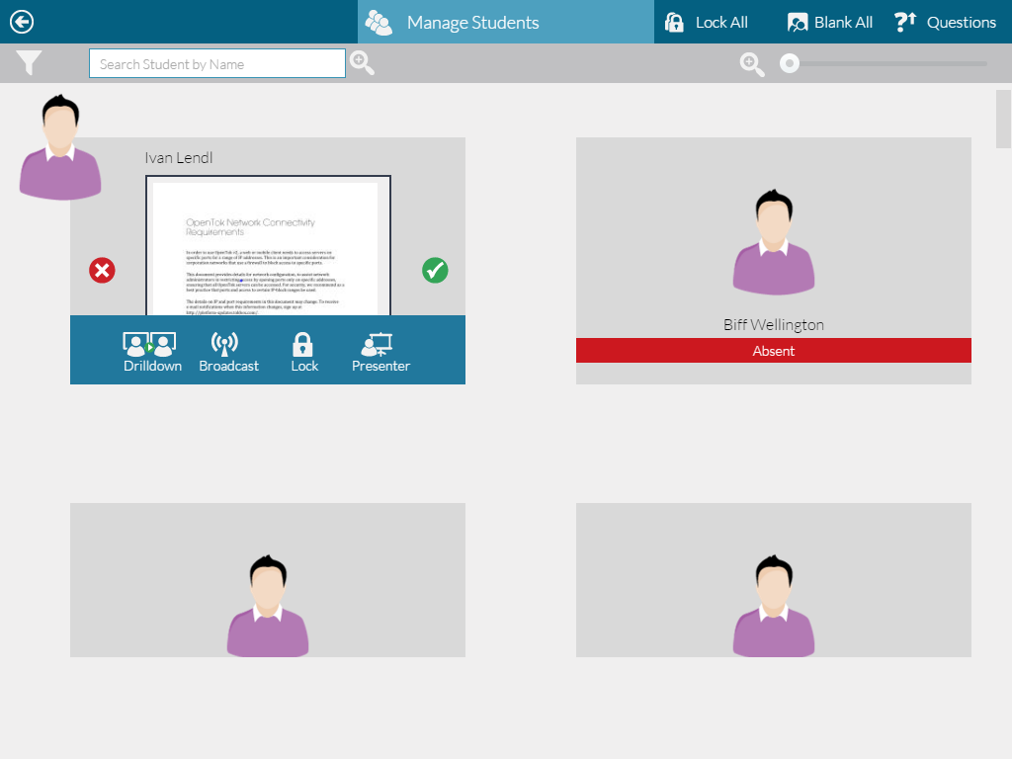
MANAGE STUDENTS
To Sort Students as per Online first, name ASC, Name DSC
5
6
7
To Zoom ‘Student view’ window
Click on the Student window to get the following options:
To drilldown the student screen on to teacher screen
To broadcast the student screen to all students
To Lock the student screen
To make the student a presenter
To Lock all student screen at the same time
To Blank all student screen at the same time
To view questions raised by students
1
2
3
4

Slide 20
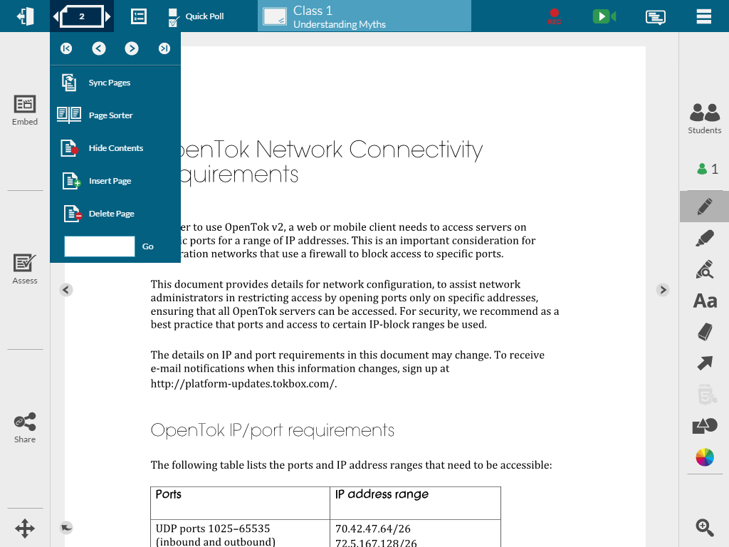
PAGE NAVIGATION TOOLS
Click here to get page navigation tools
1
3
2
4
5
To go to First Page
To go to previous page
To go to Next page
To got to Last page
To sync pages of the students
To view Page Sorter
To Hide Content on a Page
To Insert a New Page
To Delete a Page
To Go to a Specific page number
6
7
8
9
10

Slide 21
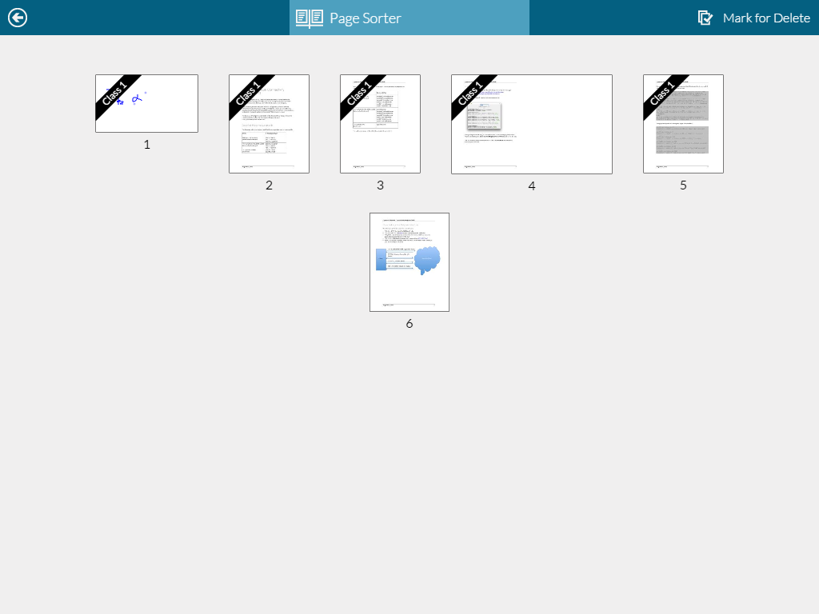
PAGE NAVIGATION TOOLS PAGE SORTER
Mark for Delete
Teacher can click on the page to visit that page
Teacher can delete a page by clicking on Mark for Delete

Slide 22
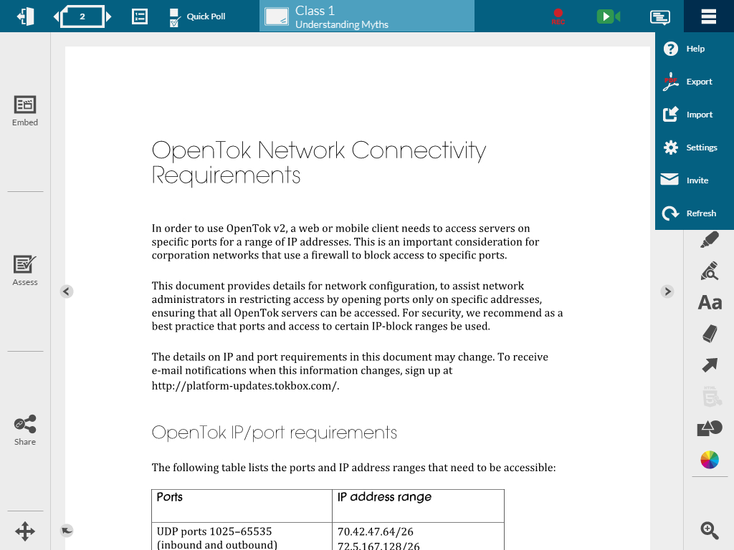
TEACHER SETTINGS
1. Click here to get settings tab
2. Click here to open settings pop-up

Slide 23
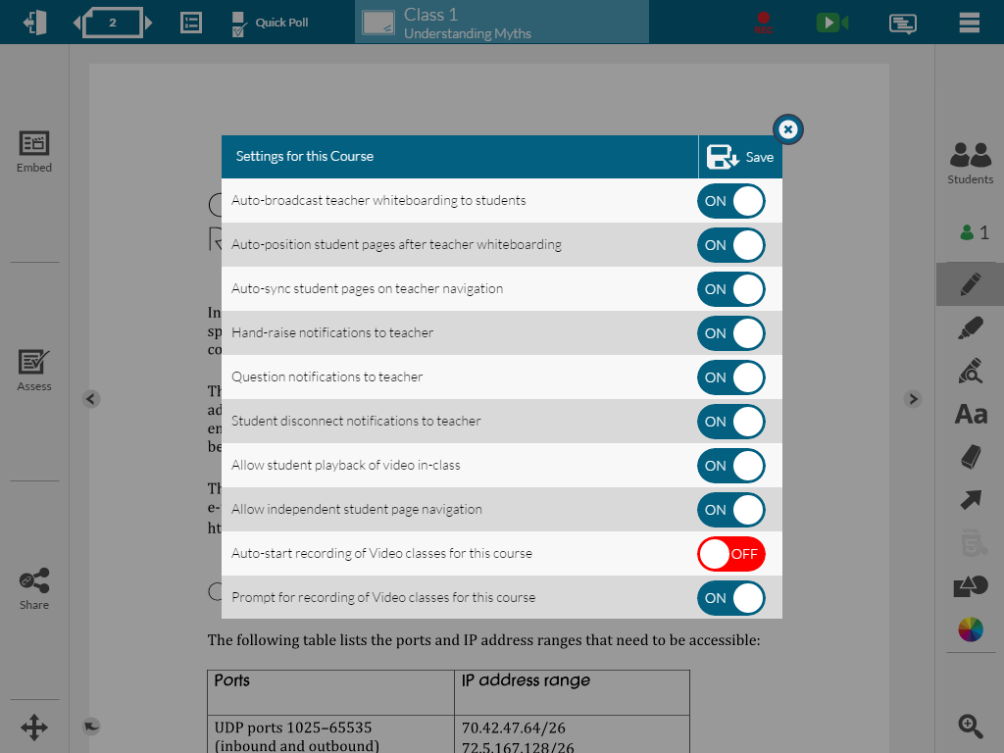
TEACHER SETTINGS
3. Change the settings here
4. Click ‘Save’ to effect changes

Slide 24
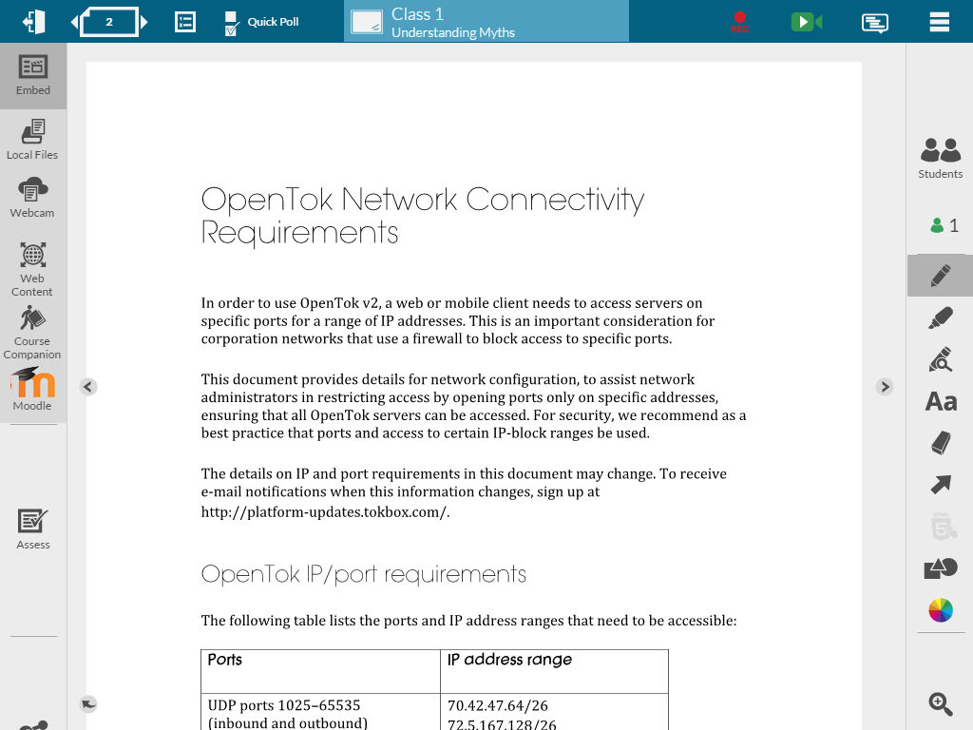
EMBED TOOLS
Click here to Embed Tools
Embed from Local files (For Laptop / Desktop / Android and Windows Tablet
Embed from Webcam
Embed from Web Content (You tube Videos / Google images)
Embed from Course Companion

Slide 25
EMBED TOOLS EMBED FROM LOCAL FILES (THIS WILL NOT APPEAR ON A TABLET)
1. Click here to Embed from local files

Slide 26
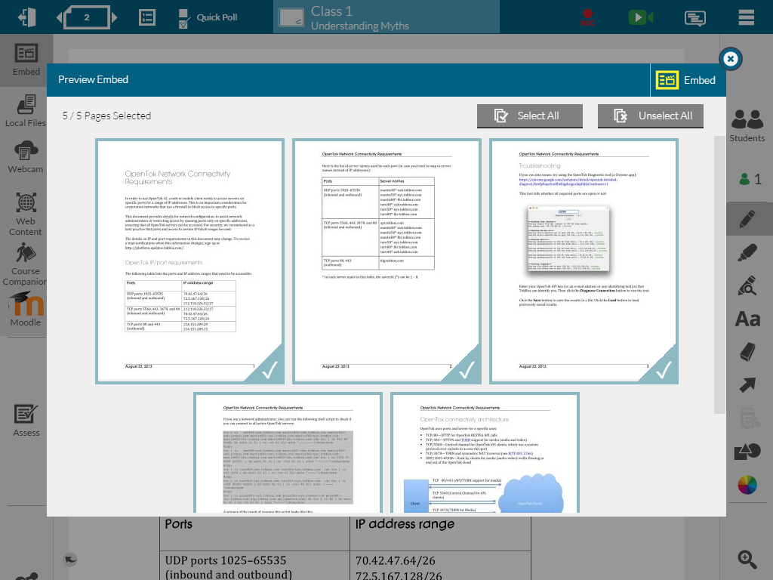
EMBED TOOLS EMBED FROM LOCAL FILES (THIS WILL NOT APPEAR ON A TABLET)
3. Click Embed
2. Select pages to Embed

Slide 27
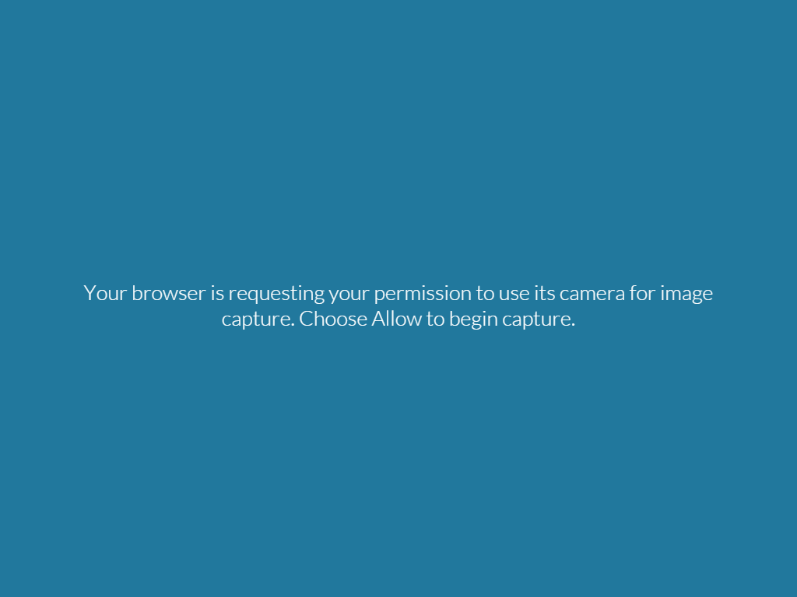
EMBED TOOLS EMBED FROM CAMERA

Slide 28
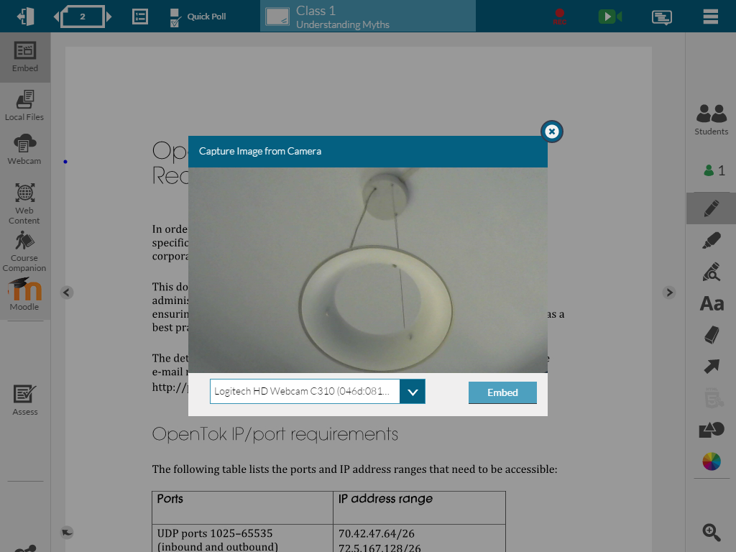
EMBED TOOLS EMBED FROM CAMERA
1. Take the Picture
2. Click Embed

Slide 29
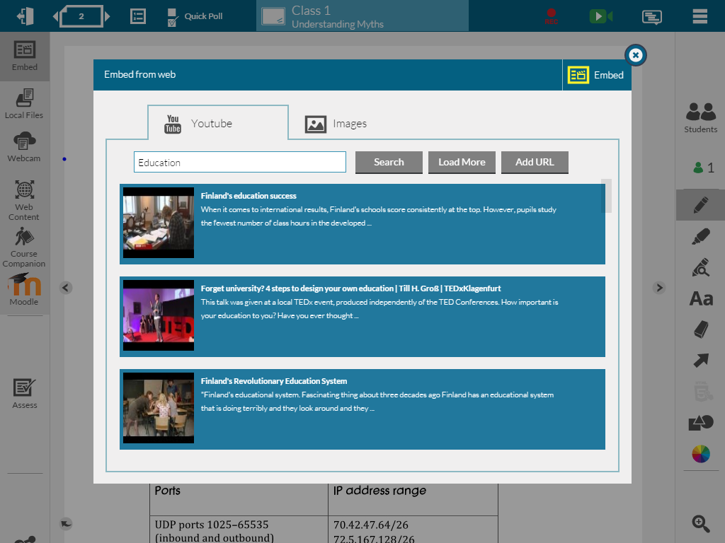
EMBED TOOLS EMBED FROM WEB
Click here for YouTube videos
Enter details to search video / image
Click for Web Content

Slide 30
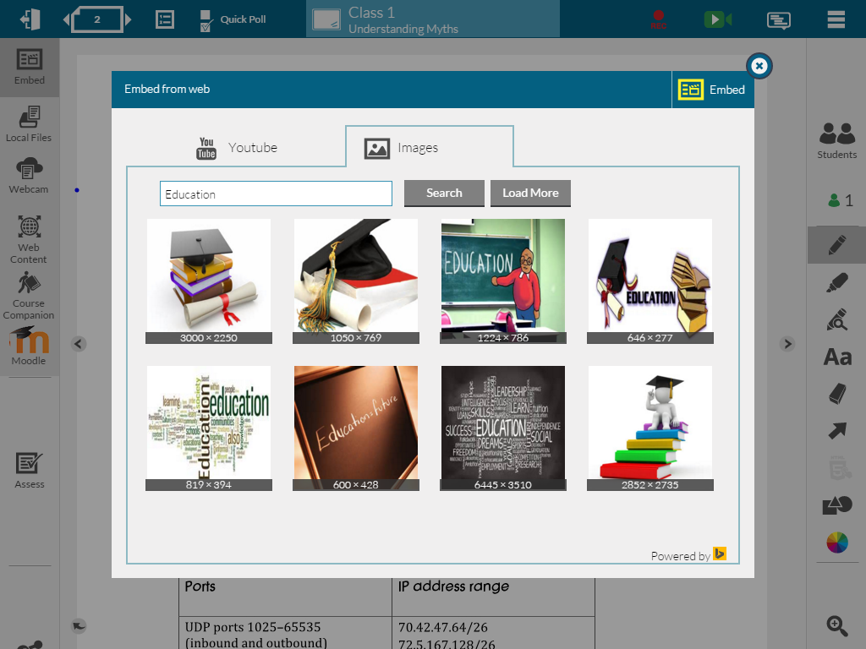
EMBED TOOLS EMBED FROM WEB
2. Click Embed
1. Select Image

Slide 31
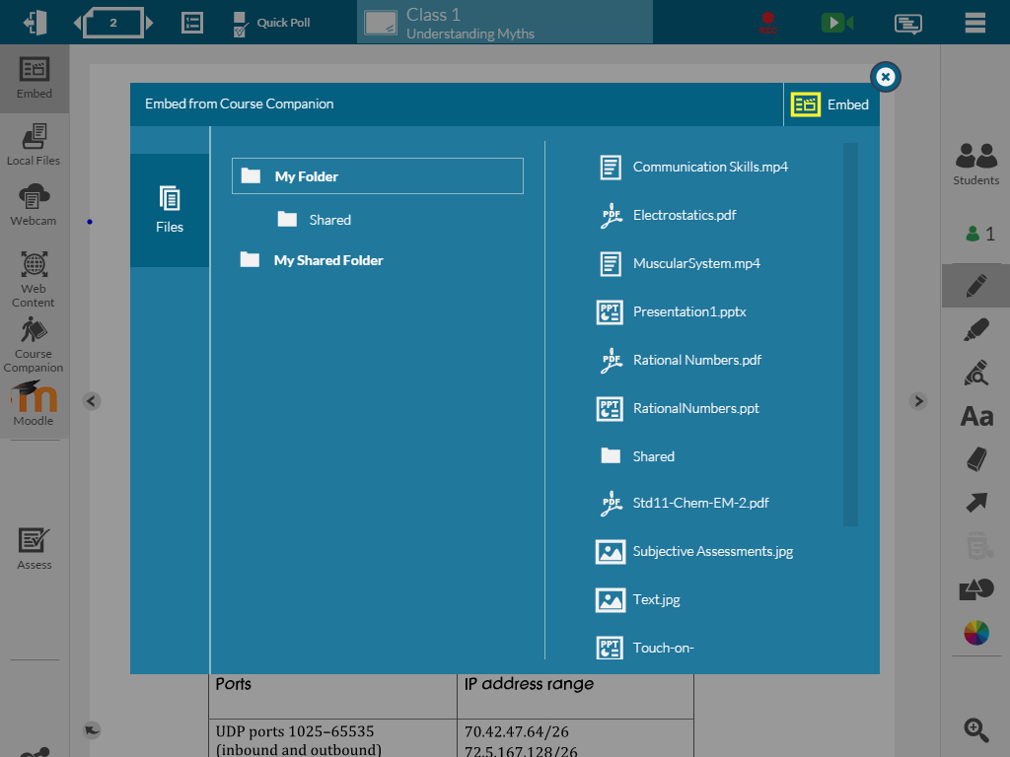
EMBED TOOLS EMBED FROM COURSE COMPANION
3. Click Embed
1. Click here to embed from Companion
2. Select the file

Slide 32
EMBED TOOLS EMBED FROM COURSE COMPANION
5. Click Embed
4. Select the pages to Embed

Slide 33
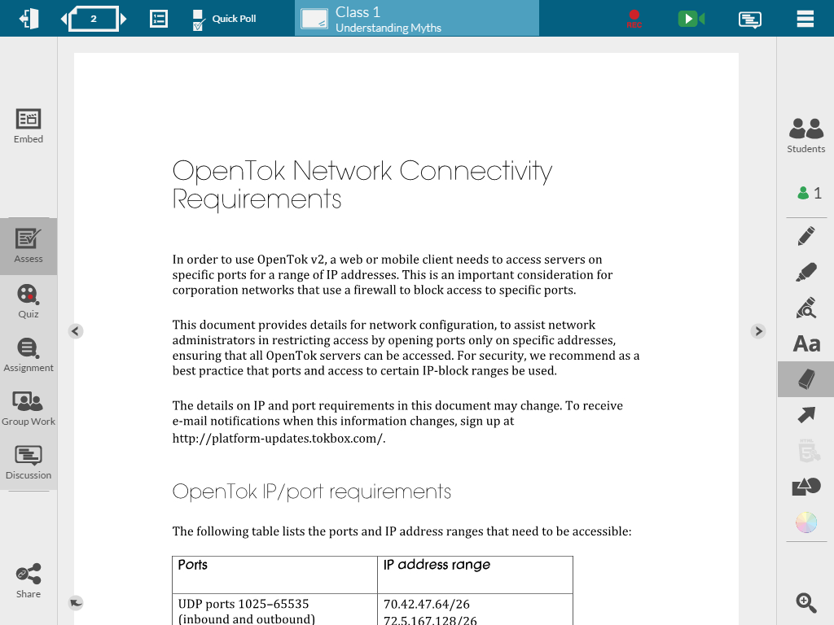
QUIZ
Click here to get Assess Tools
Click here to open Quiz draft window

Slide 34
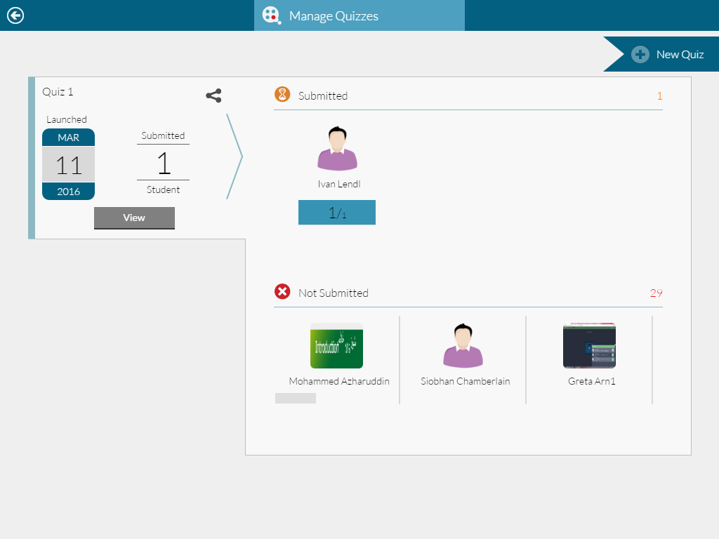
QUIZ
Click here to create new Quiz

Slide 35
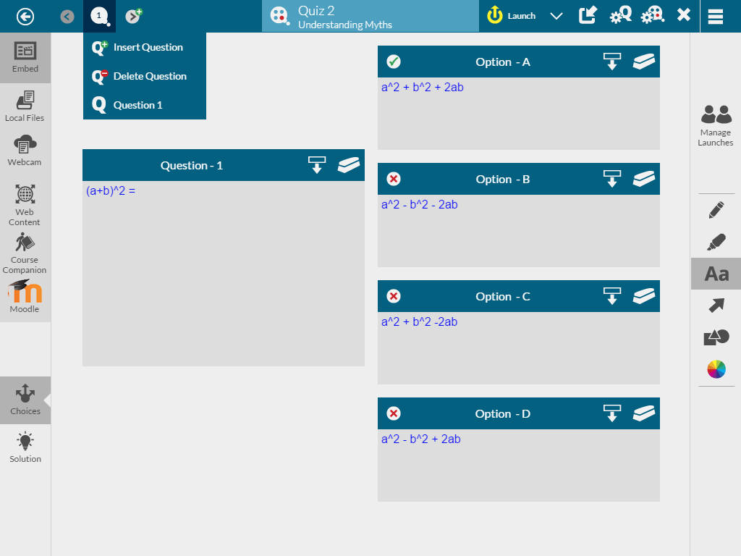
QUIZ
1
1
1
1
Add another Question
Insert a Question
Delete a Question
Embed an Image in the Question or Solutions

Slide 36
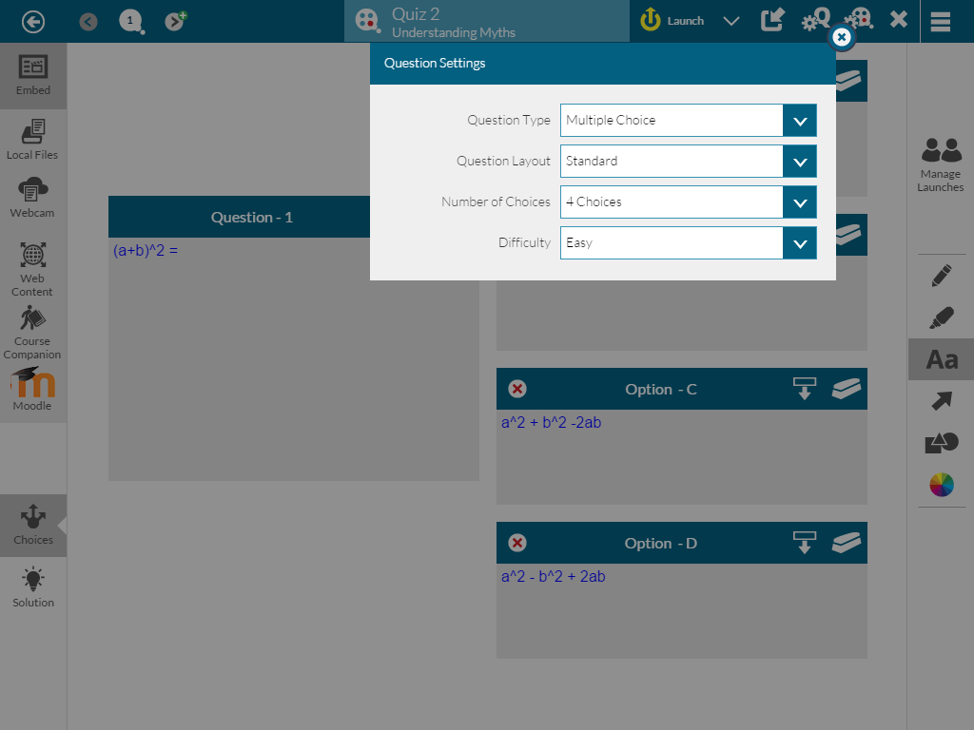
QUIZ
Click here to get Question Settings
1
2
3
4
To change Question Type
To change Question Layout
To change number of choices against the question
To set the difficulty level

Slide 37
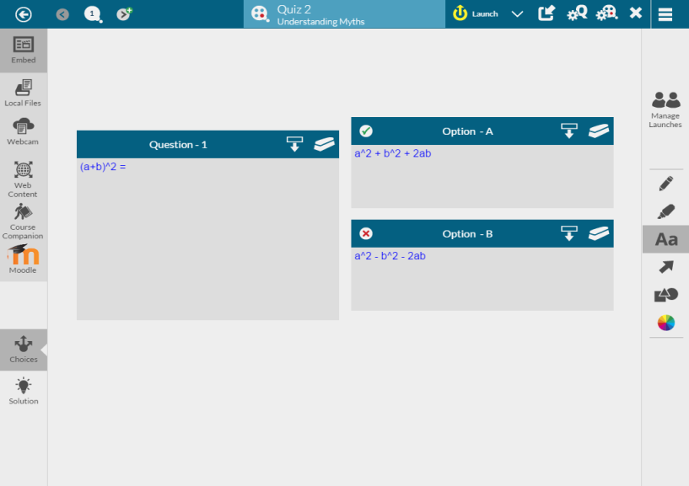
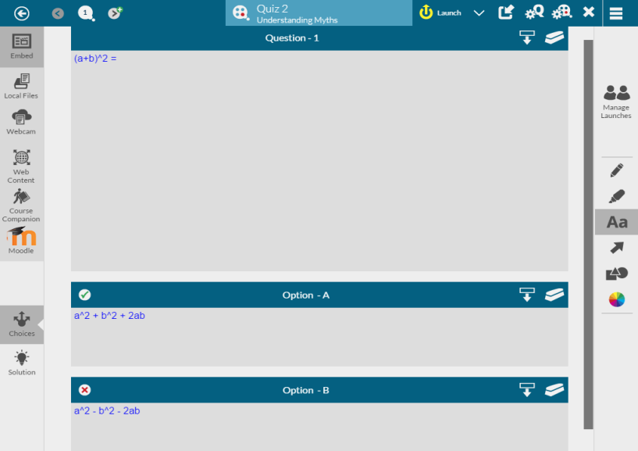
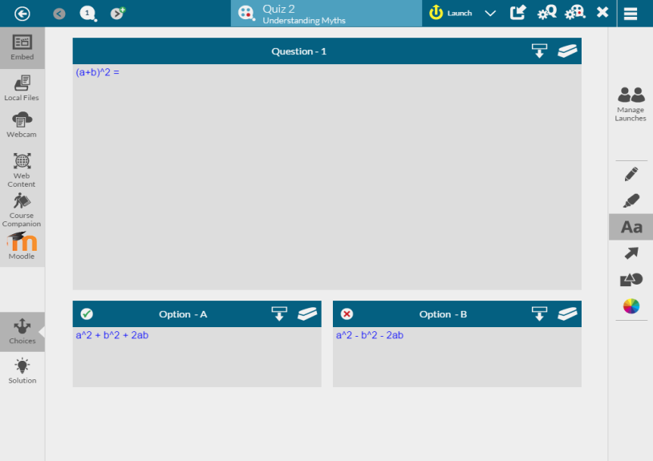
QUIZ
Standard Layout
Vertically Stacked
Matrix Layout

Slide 38
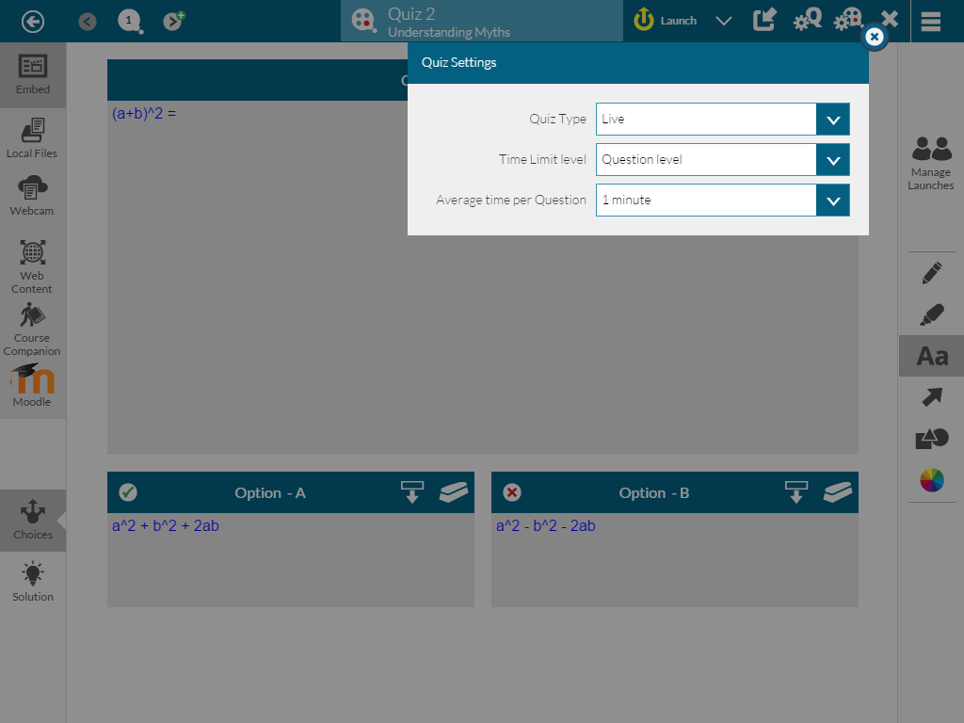
QUIZ
Click here to get Quiz level Settings
1
2
3
Quiz Type
Time Limit to set as per quiz or as per questions
Total time for Quiz or Avg. time per question

Slide 39
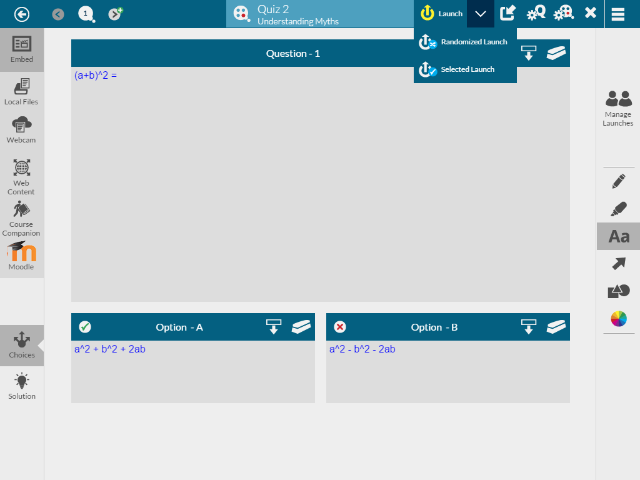
QUIZ
Click here to do normal Launch of a Quiz
Click here to do Randomized or Selected Launch
1
2
1. Normal launch launches the quiz to all students in the order of quiz set.
2. Randomized launch allows to launch questions in different set of sequence to all students
3. Selected Launch allows you to select the students whom you want to launch the quiz
3

Slide 40
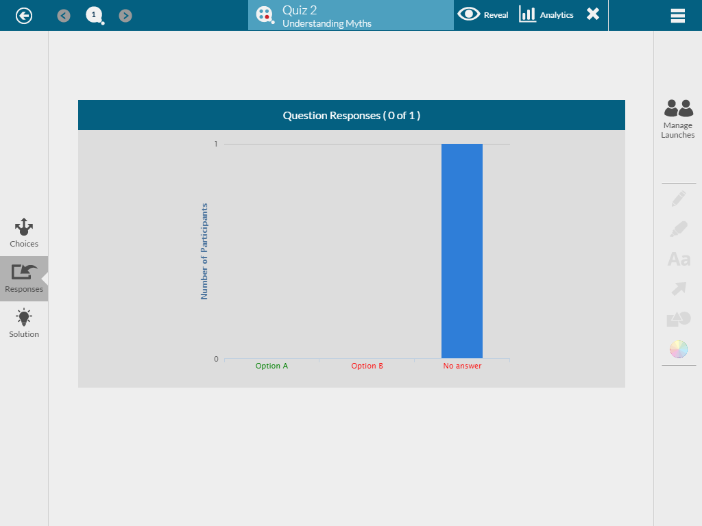
QUIZ
Teacher screen will look like this when the quiz is launched

Slide 41
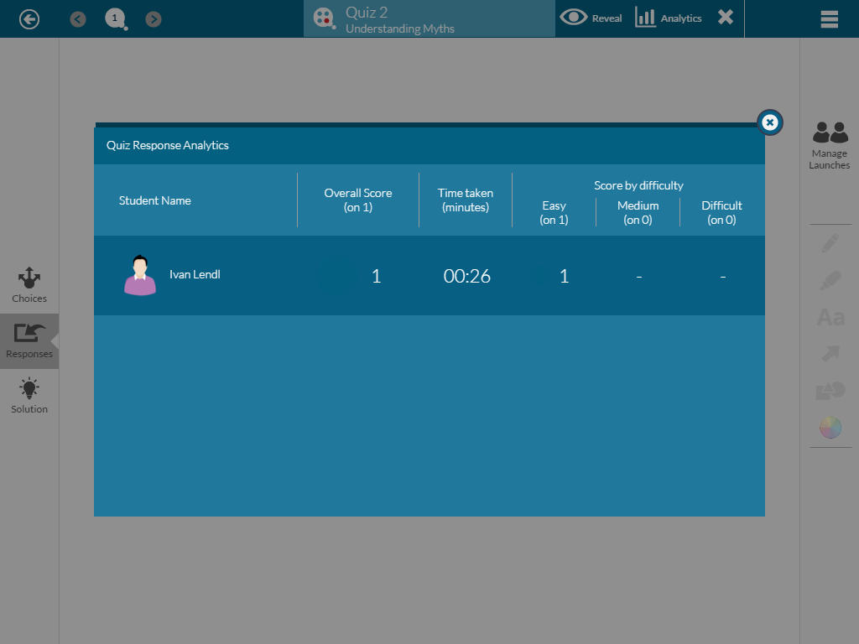
QUIZ
Click here to do reveal the answers to the students
Click here to get the Analytics of the Quiz launched
Analytics gives useful information of all the students who answered quiz like Overall Score, Time taken to answer the quiz etc.

Slide 42
ASSIGNMENT
Click here to open Assignment

Slide 43
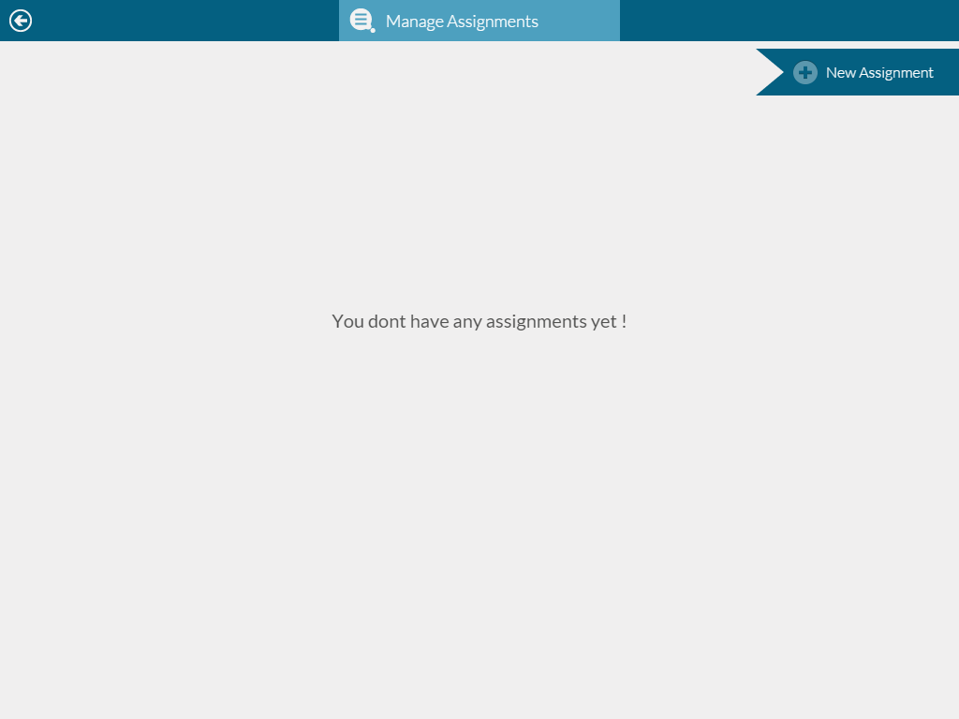
ASSIGNMENT
Click here to create new Assignment

Slide 44
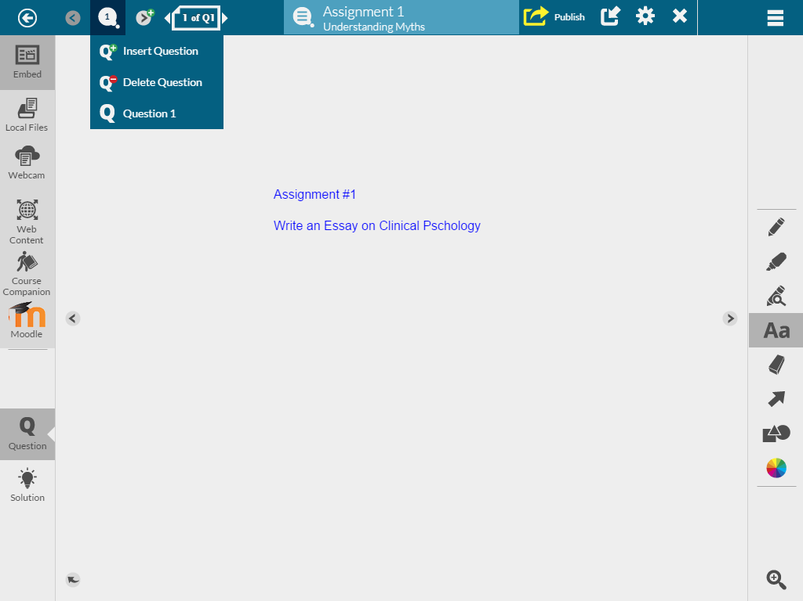
ASSIGNMENT
2
3
4
1
To Embed from various sources
To add a new question on new page
To insert a question
To delete a question

Slide 45
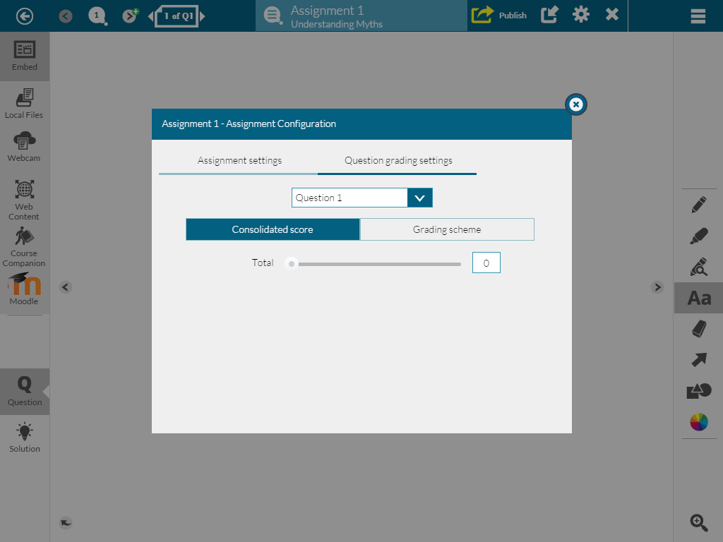
ASSIGNMENT
3
2
1
To set assignment settings and score
To import assignment from other Course and Lesson
To publish an assignment

Slide 46
DISCUSSIONS
Click here to open Discussion

Slide 47
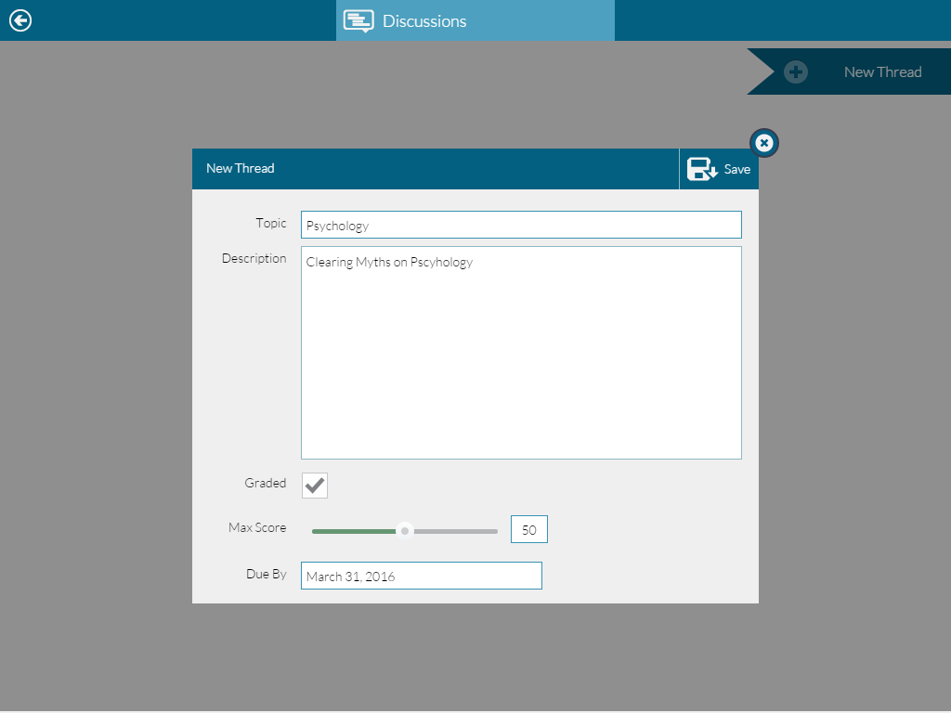
DISCUSSIONS
1
6
2
Click to start a new thread
Topic and description for discussions
Tick the check box for graded discussion
Move the slider for max score
Set the due date
Click on save to launch the discussion
3
4
5

Slide 48
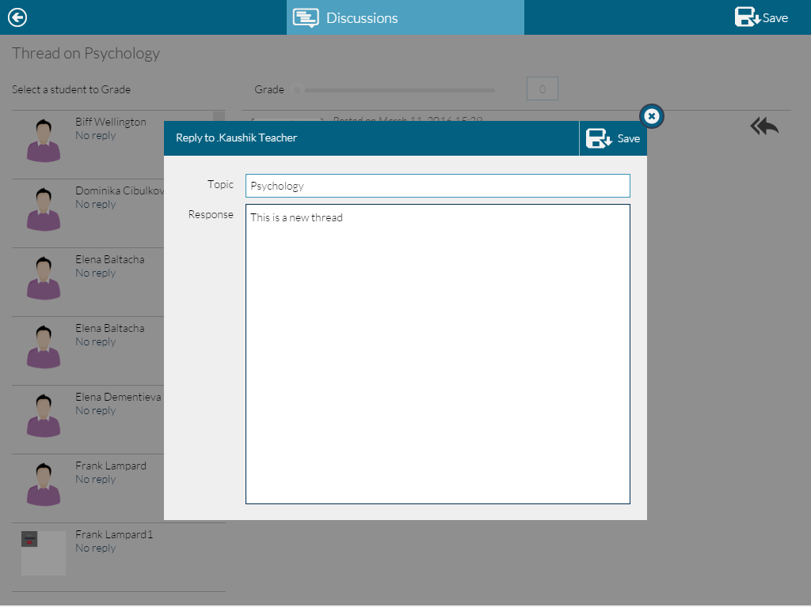
DISCUSSIONS
6
5
3
1
2
Click here to post your reply
Enter your response
Click here to save your response
Select the student to view the response
Move the slider to grade the response
Click here to save
4

Slide 49
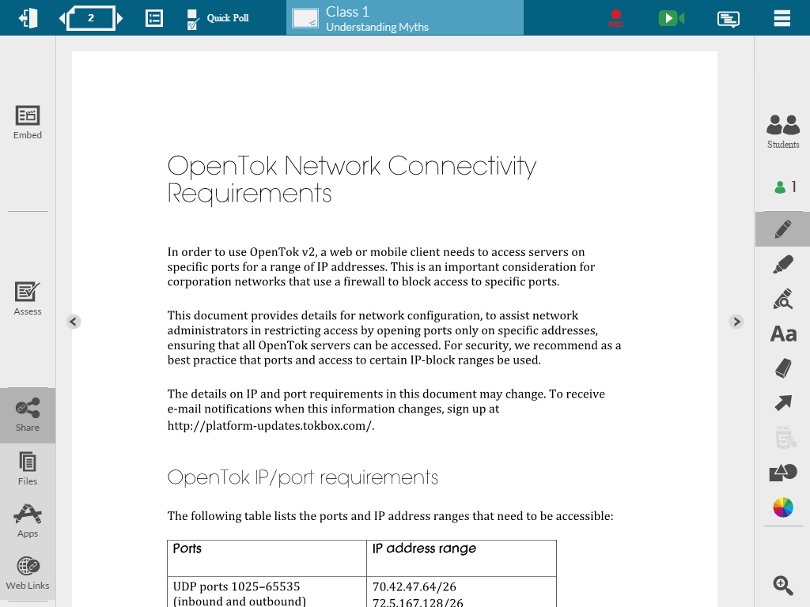
SHARE FILE
Click here to Share File

Slide 50
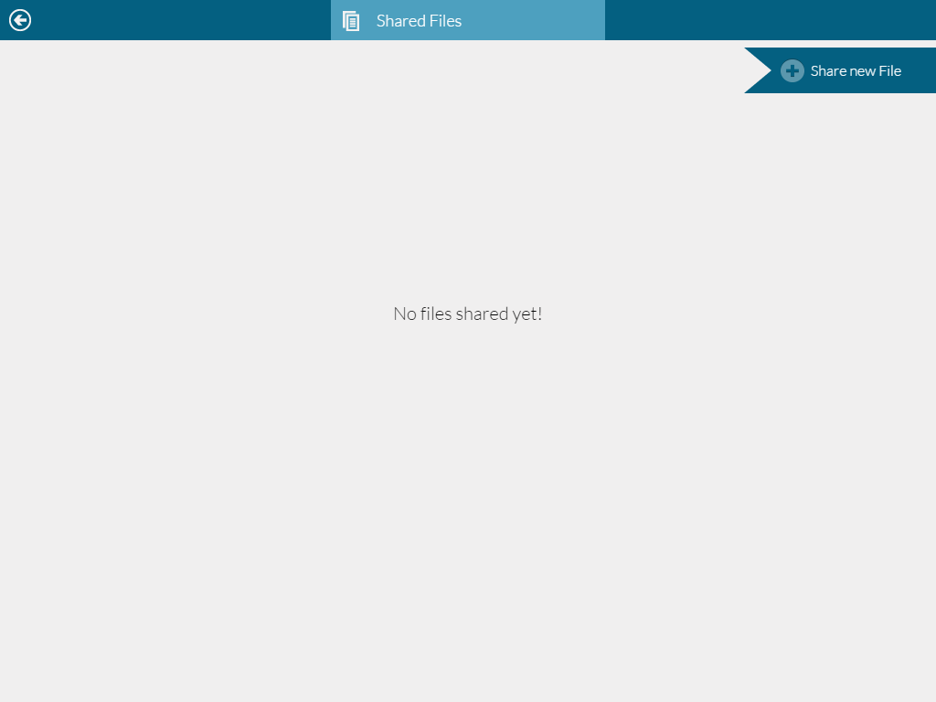
SHARE FILE
Click here to share a new file

Slide 51
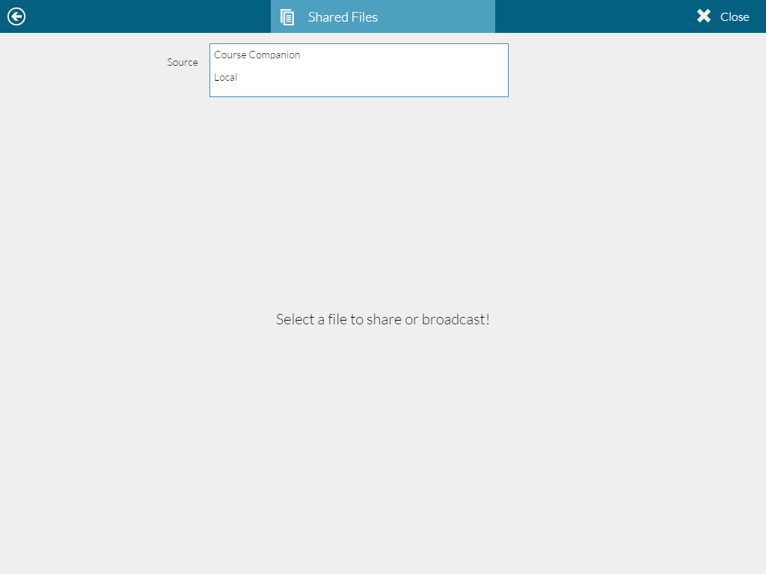
SHARE FILE
Click here to close
Select file source

Slide 52
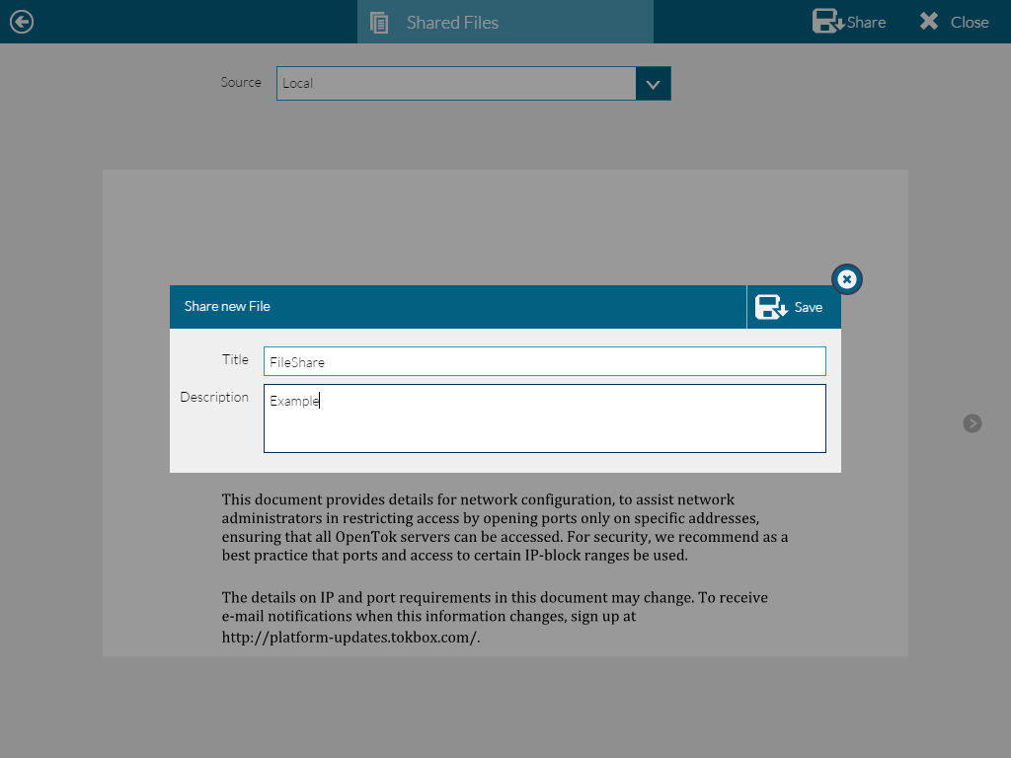
SHARE FILE
Click to share
Click to save
Enter title and description

Slide 53
SHARE WEB LINK
Click here to share web link

Slide 54
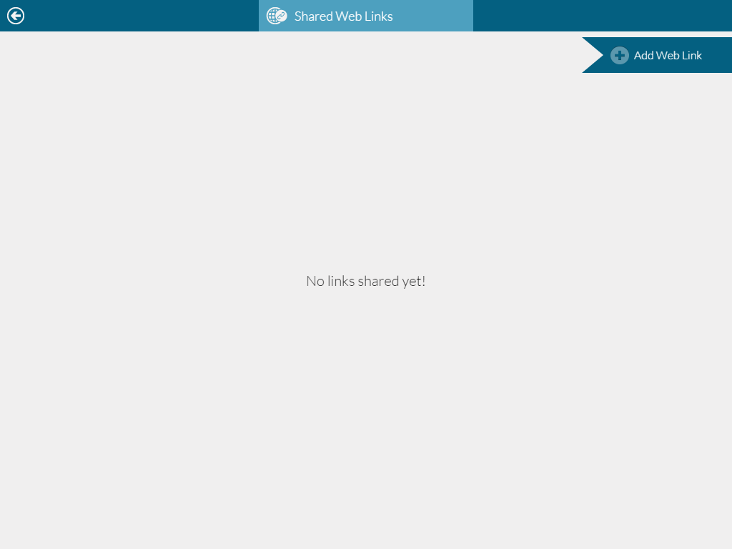
SHARE WEB LINK
Click here to Share a new web link

Slide 55
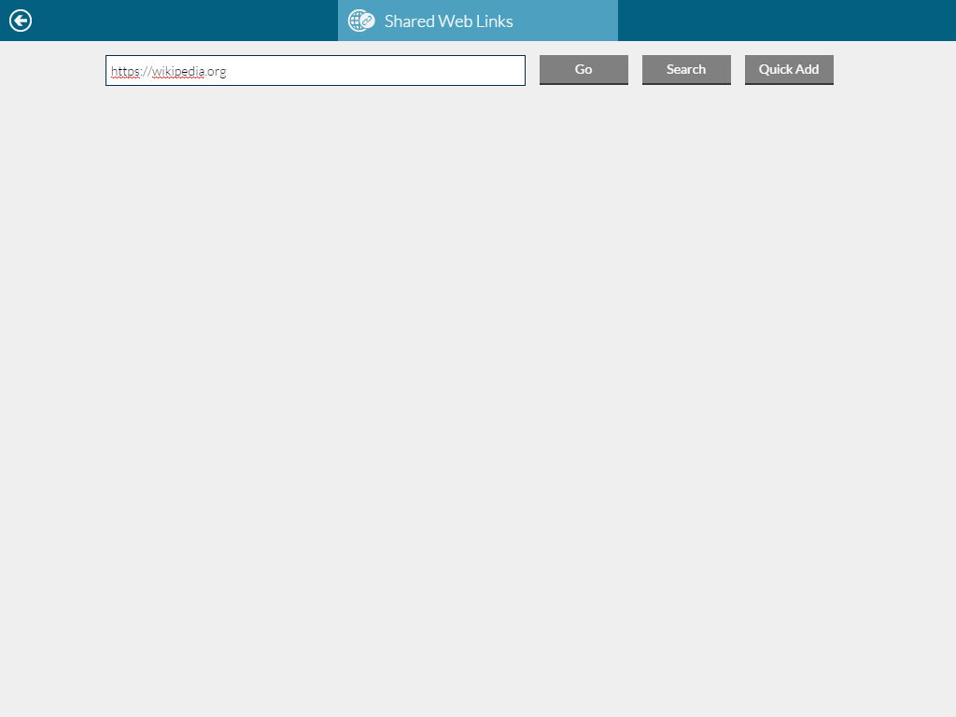
SHARE WEB LINK
Type the URL
Click ‘go’ to open the webpage
Click ‘quick add’ to share the link without opening webpage
Click ‘search’ to search for the webpage

Slide 56
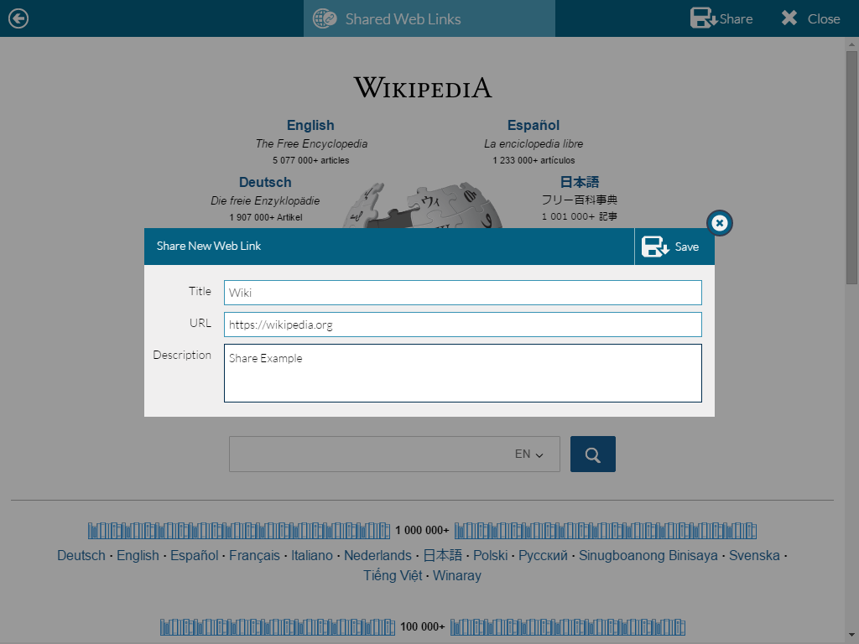
SHARE WEB LINK
Click to share
Click to save
Type title and description

